Slide 1
Clinician Awards
2023

Slide 2
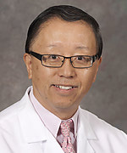
EXCELLENCE AWARD 2023
Yunli Zheng, M.D., Ph.D.
Internal Medicine, Roseville
Notes:
Comments from patients:
“Dr. Zheng's 3 best qualities: he is knowledgeable, he listens, and he cares. Highest marks without question!”
“Dr. Zheng was one of the best doctor's I've had. It felt like he was actually listening to what I was telling him.”
Multiple “Dr. Zheng is the best!”

Slide 3
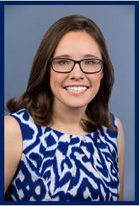
EXCELLENCE
AWARD 2023
Danielle Tartar, M.D.
Dermatology
Notes:
Comments from patients:
“She has a wonderful way of putting patients at ease and communicates very well as she is also a good listener! I am grateful to be in her care!”
“I drive 1 1/2 hours to see Dr Tartar since my move. I continue to do so because I have 100 percent confidence in her skills and knowledge plus she is such a nice person to boot!”
“Dr. Tarter has excellent communication skills. She's knowledgeable, informative, reassuring, and compassionate. I think she is an exceptional doctor.”

Slide 4
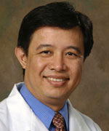
EXCELLENCE AWARD 2023
Ethelwoldo Guerrero, M.D.
Internal Medicine, Roseville
Notes:
Comments from patients:
“There are not enough superlatives to describe the excellent care we receive from Dr. Guerrero. He is simply the best! He should train doctors worldwide.”
“The best Dr. That I have had in the last 30 years”
“Dr. Guerrero is a consummate professional”

Slide 5
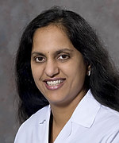
EXCELLENCE AWARD 2023
Radhika Nandur Bukkapatnam, M.D., M.A.A.S.
Cardiology, Roseville
Notes:
Comments from patients:
“The very best doctor anyone could want.”
“I'm 85 and over my years she's one of the best doctors I've ever had. Excellent doctor.”
“Dr. Bukka is such a incredible asset to UCD. Her vast knowledge and caring are always comforting to me. She is a cut to the chase doctor and I love that. When I ask her a question I get an honest direct answer. UCD is fortunate to have her on staff”

Slide 6

INNOVATION AWARDS
Joseph Andrade, D.O.
Stacey Brezing, M.S., R.C.E.P., N.B.C.-H.W.C.
Sara Brundage, D.O., M.S.
Cherie Ginwalla, M.D.
Eric Giza, M.D.
Jenny Goddeau
Tiffany Hu, M.D.
Alexandra “Ali” King
Emily Lane, M.D.
Mary Claire Manske, M.D., M.A.S.
Zach Pope, M.D., M.P.H.
Ivy Song, M.D.
Sherzana Sunderji, M.D.
Ilana Halperin, D.V.M.

