Slide 1
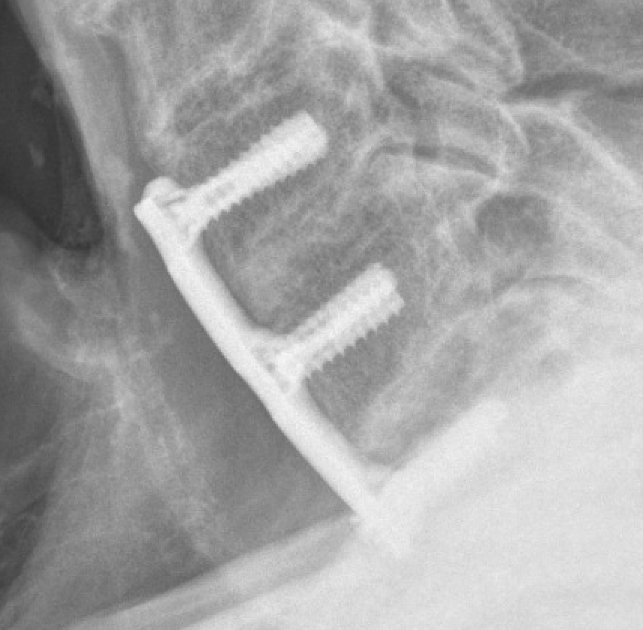

Comparing Fusion Rates Between Fresh-Frozen and Freeze-Dried Allografts in Anterior Cervical Discectomy and Fusion (ACDF)
Derron Yu B.S., Dr. Connor Delman M.D., Paramjyot Singh B.S., Benjamin Van B.S., Dr. Eric Klineberg M.D.
Spine Center University of California-Davis, Sacramento, CA
Introduction
Methodology
Results (Preliminary)
ACDF is used to treat a variety of cervical pathologies (degenerative disease, myelopathy, etc.)¹
Post-operative pseudarthrosis, nonunion, is defined as a failure of fusion between cervical levels.
Pseudarthrosis is a leading cause of pain post-operatively resulting in 45%-56% of revision surgeries.¹
The “gold standard” graft for ACDFs is an autograft from the patients iliac crest.²
Autografts lead to a higher level of fusion rates, however, can cause a number of donor site morbidities. ²⁻⁷
To reduce these morbidities, allografts are frequently used as an alternative.
Allografts usually are freeze-dried or fresh-frozen.
Freeze-dried allografts have gone through more processing which leads to a more sterile option, but can lead to a weaker bone graft. ^{3,8-11}
Fresh-frozen allografts go through less processing, leading to preserved structural integrity but increased chances on immune response. ^{3,8-11}
Retrospective consisting of 117 patients that underwent ACDF in a span of 8 years
Freeze-dried allografts and fresh-frozen allografts were given to patients on physician’s preferences and suggestions
Co-morbidities and patient history such as smoking, osteoporosis, obesity, and diabetes were recorded. These factors are shown to affect fusion rates. ^{1,10, 11}
Freeze-dried and fresh-frozen allografts were processed and preserved through standard protocol.
64 patients received the Freeze-dried allograft.
43 patients received Fresh-frozen allograft
Fusion was observed through post-op AP/Lat radiographs by observing trabecular bridging on the superior and inferior borders.¹²(Table. 1 Fig. 1)
Three independent observers graded fusion for each radiograph. An average of fusion percentages was used to determine fusion grade
-Upon preliminary analysis, it has shown that there were no significant differences in fusion rates between freeze-dried and fresh-frozen allografts in the first follow-up dates and second follow-up dates. (Fig. 2 & Fig. 3)
-First follow-up dates are averaged to be 19 weeks. The second follow-up dates are averaged to be 51 weeks.
Figure 2: At first radiographic follow-up, there was no difference in the percent fusion (Column 2) between allograft type at 77% for graft A (Freeze-dried) and 82% for graft B (Fresh-frozen). (p=0.11)
Figure 3: At final radiographic follow-up, there was no difference in the percent fusion (Column 3) between allograft type at 88% for graft A (Freeze-dried) and 92% for graft B (Fresh-Frozen). (p=0.06)
Fusion Grade | Criteria
Union | Complete bridging <20 weeks
Delayed Union | Complete bridging 20-52 weeks
Partial Union | <50% bridging on one or more graft surfaces
Non-Union | Lack of bridging on one or more surfaces 20-52 weeks
Conclusion
-Due to no statistical significance in fusion rates between fresh-frozen and freeze-dried allografts, physicians can choose between either grafts for ACDFs on availability and cost efficiency for the hospital.
Hypothesis
Abstract and References.
We hypothesize that fresh-frozen allografts, given their persevered structural integrity, will reduce the rate of pseudarthrosis in patients.
Table 1: Criteria and guidelines to determine fusion at each cervical spine level. ¹²
Figure 1: Cervical levels that show complete trabecular bridging on superior and inferior levels.
qrd.by/p47fon

