Slide 1

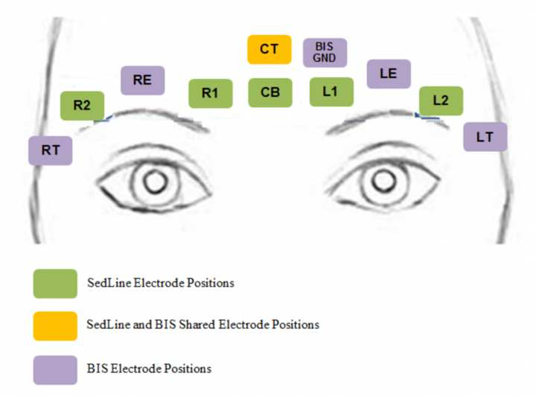
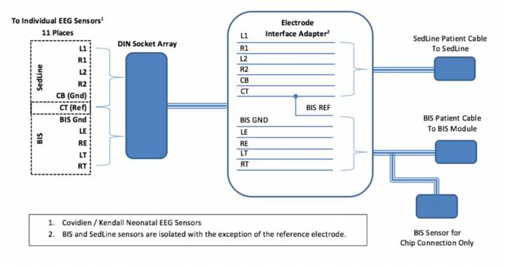
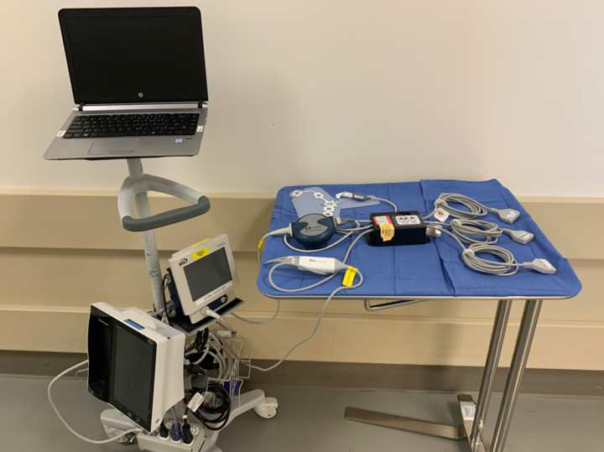
Comparison of Depth of Sedation Performance between SedLine and BIS during General Anesthesia: Data Collection and Analysis
Linda L. Vo AB, Penelope Kim-Lim BS, James H. Jones MD, Richard L. Applegate II MD, Neal W. Fleming MD PhD, Department of Anesthesiology and Pain Medicine, University of California, Davis, Sacramento, CA
Introduction
Objectives
Results (In Progress)
Electroencephalogram (EEG) monitoring has the potential to become a robust tool to characterize anesthetic depth. The goal is to develop a streamlined neuromonitoring tool that would allow clinicians to make real-time assessments and to titrate anesthetic delivery. Anesthetic overdosing can cause postoperative delirium and mortality, while underdosing can cause intraoperative awareness and pain. Of particular interest is excessively deep anesthesia, which is reflected by a burst suppression pattern on EEG monitors. Fortunately, proprietary algorithms have been developed to transform the raw EEG waveforms into a dimensionless number that quantifies the patient’s level of consciousness. Examples of these monitors are the Bispectral Index (BIS) monitor and the Sedline monitor which produces patient state index (PSI) values.
Question: How do the PSI (SedLine) and BIS perform in the setting of imminent burst suppression during general anesthesia?
Collect data on 100 patients using individual generic sensors connected to a custom-built passive interface box, which allows for concurrent performance of BIS and SedLine monitors
Analyze processed EEG performance in the 5 minutes prior to the onset of burst suppression pattern on raw EEG (indicating an overly deep level of anesthetic sedation).
Developed an individual electrode connected to a custom designed interface box that can combine and split signals, allowing simultaneous data gathering for two different brain monitoring systems.
100 patients were enrolled in this prospective, non-blinded, non-randomized study
Successful data collection using BIS and SedLine monitors
Reviewers of burst suppression on raw EEG completed training
  Initiated marking of raw EEG data for burst suppression by 4 independent reviewers
Further Study
Figure 1: Sensor Placement
Figure 2: Custom-built interface box
Next Steps: Finish Data Analysis
Establish inter-reviewer concordance on marking raw EEG data for burst suppression
Analyze the 5 minutes of processed EEG prior to burst suppression on raw EEG
Raw EEG readings will be correlated with the dimensionless values of the brain function monitors (processed indices from BIS and SedLine monitors)
Data will be analyzed using chi-square test and kappa statistic
Design
Challenges Encountered
While prior studies have compared different brain function monitors by placing multiple sensors on the patients’ foreheads simultaneously, this data is difficult to interpret due to crowded and inaccurate placement of the sensors. Our study is distinct in using an individual electrode connected to a custom designed interface box that can combine and split signals, allowing simultaneous data gathering for two different brain monitoring systems.
Prospective, non-blinded, non-randomized study conducted at a single institution
Aged ≥ 18 years
American Society of Anesthesiologists (ASA) class I-III patients presenting for elective surgical or non-surgical procedures requiring general anesthesia
Exclusion: Any deformities or devices preventing application of EEG sensors to patient’s forehead; Developmental delay
Legal approval from the lawyers of the Medtronic (BIS) and Masimo (SedLine) monitors - RESOLVED
Waiting for equipment delivery – RESOLVED
Repair of equipment used in data collection – RESOLVED
Concordance among screeners of the raw EEG waveforms for burst suppression
  Need additional training - RESOLVED
Acknowledgements
​Masimo, Inc provided support for the construction and assembly​ of the data collection hardware and software.
Figure 3: Equipment Setup
Table 1: Characteristics of Study Population

