Slide 1
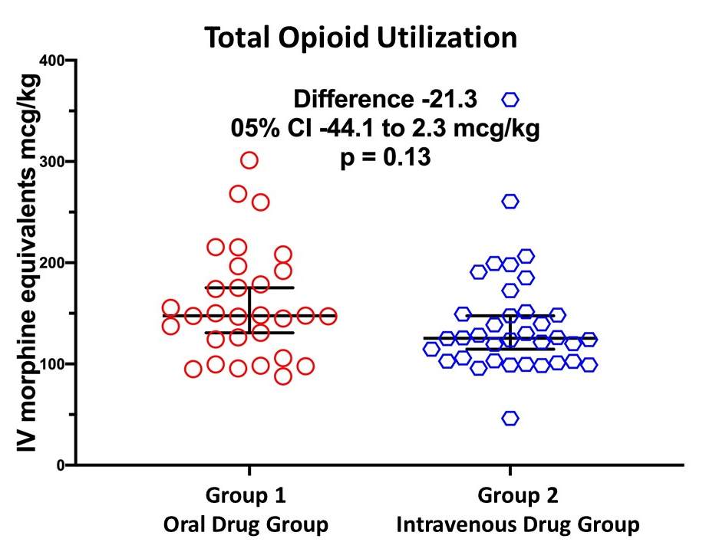
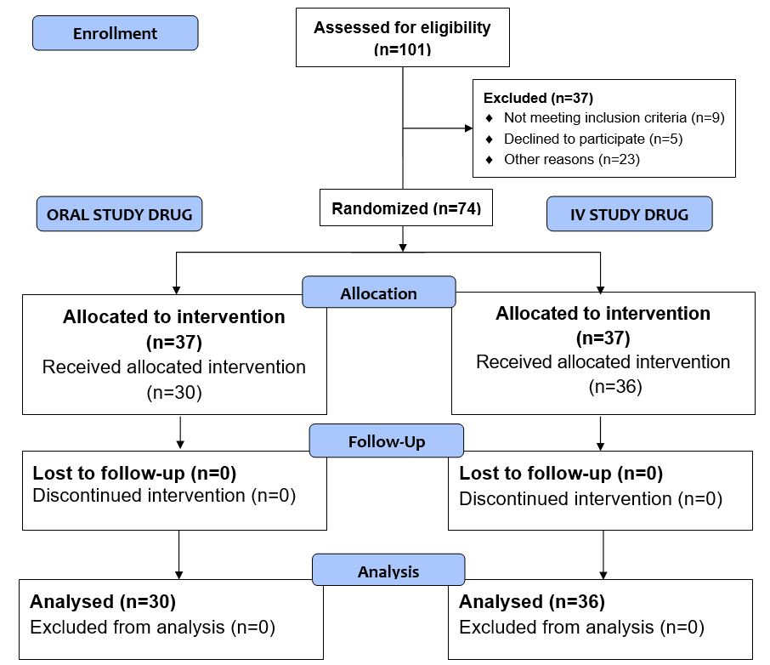
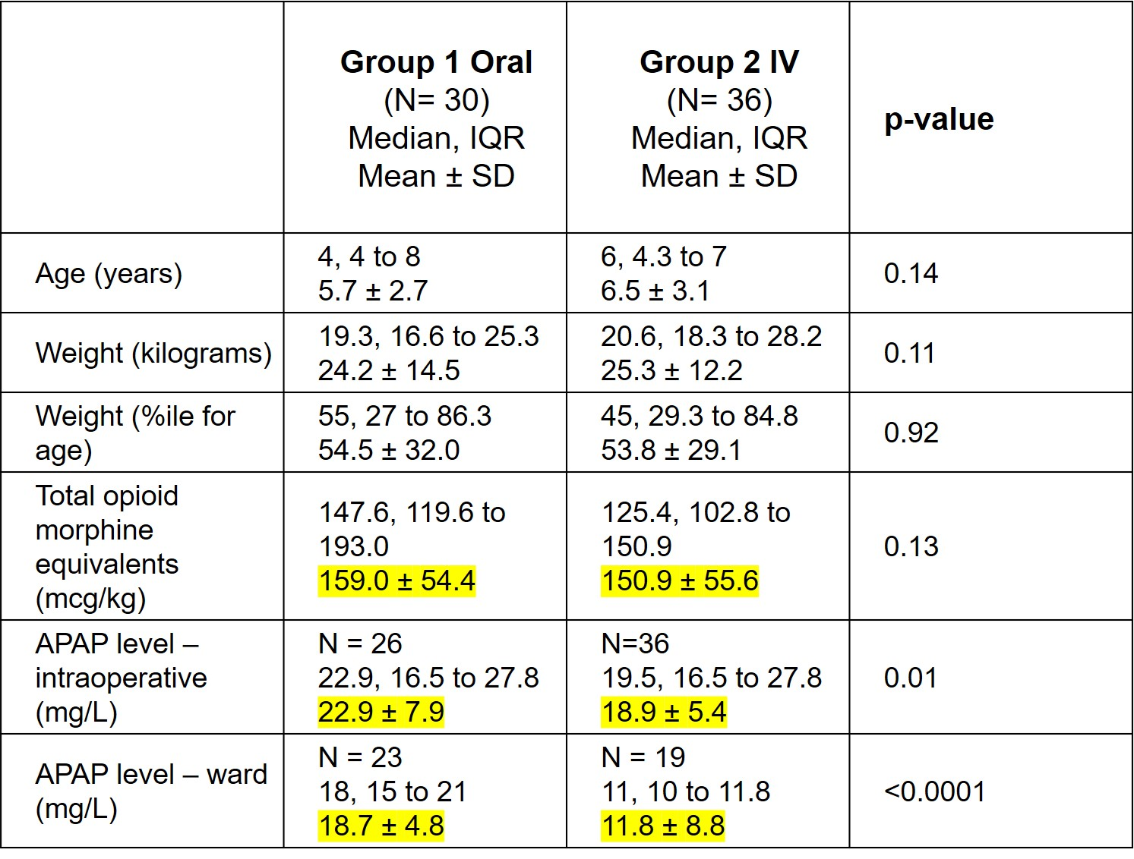
Modified Preoperative Oral Dose Acetaminophen vs Intravenous Acetaminophen in Children: A Randomized Clinical Trial
Cathy R. Lammers MD, Vinay Nittur BS, Amy J. Schwinghammer PharmD, Brent Hall PharmD,Robert S. Kriss DO, and Richard L. Applegate ll MD, FASA
INTRODUCTION
RESULTS
DISCUSSION
    Purpose: Compare opioid utilization in pediatric surgical patients undergoing tonsillectomy/adenoidectomy using
    Modified preoperative oral vs IV acetaminophen
    Standard multimodal pain regimen
    Hypothesis: One loading dose of PO acetaminophen given pre-operatively will provide superior opioid sparing effects compared to one standard dose of IV acetaminophen.
The difference in total opioid dose between groups was not clinically or statistically significant
No opioids required after PACU admission
No patient exceeded acetaminophen level of 40 mg/L
Oral loading dose of acetaminophen may provide comparable postoperative surgical pain control to a single IV dose
Ward APAP levels were higher in the PO group compared to the IV group
Acetaminophen PO syrup price/mg: $0.0006/mg or $2.24 for a standard size 3776mg bottle
Acetaminophen IV form price/mg - $0.06/mg or $58.44 for a standard size 1000 mg/bottle
Modified Preoperative Oral Dose Acetaminophen vs Intravenous Acetaminophen Patient Characteristics and Results
METHODS
CONCLUSION
Oral loading dose of 30 mg/kg provided similar opioid sparing compared to an IV loading dose of 15mg/kg
May provide the basis for more consistent acetaminophen therapeutic levels
REFERENCES
Intraoperative APAP level drawn at emergence
Ward APAP level drawn 3 hours after study drug administered
Anderson BJ et al . Perioperative pharmacodynamics of acetaminophen analgesia in children. Anesthesiology 1999;90:411-21.
Nour C, et al.Analgesic effectiveness of acetaminophen for primary cleft palate repair in young children: a randomized placebo controlled trial. Pediatric Anaesth2014;24:574–81
Rumack BH, Matthew H. Acetaminophen poisoning and toxicity. Pediatrics 1975;55:871-6
METHODS
METHODS
METHODS
METHODS

