Slide 1

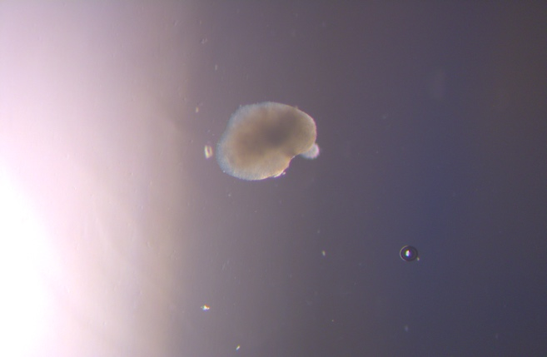
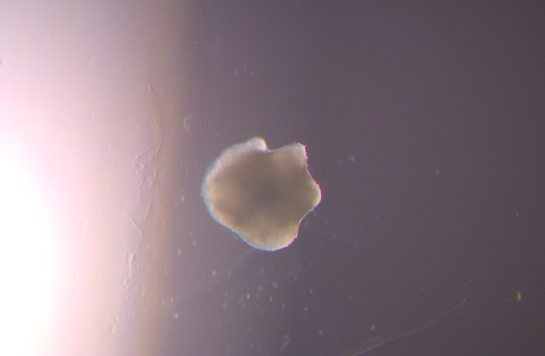
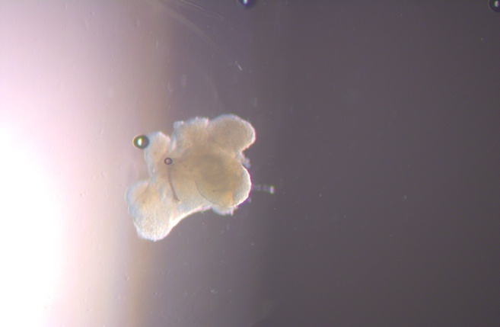
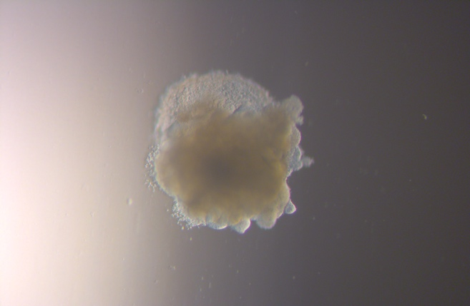
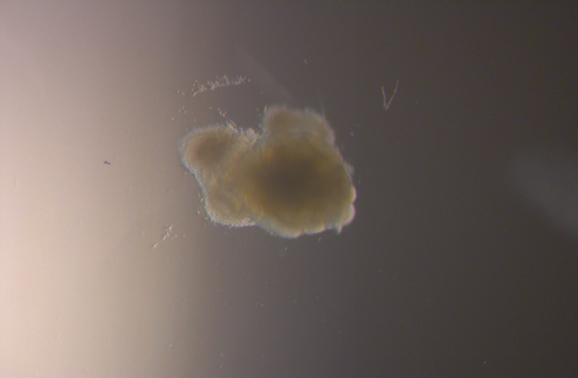
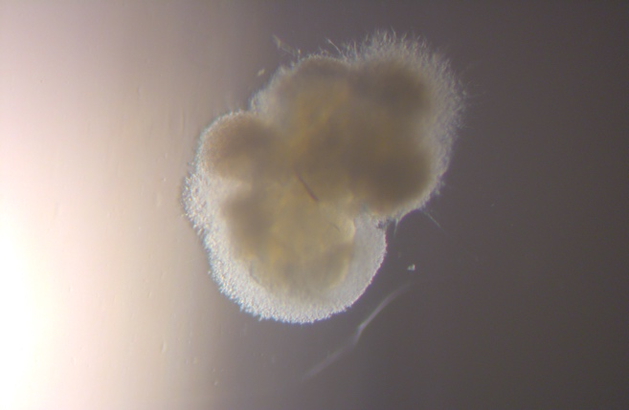
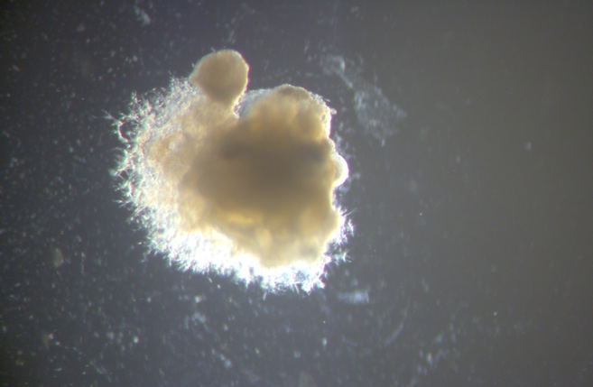
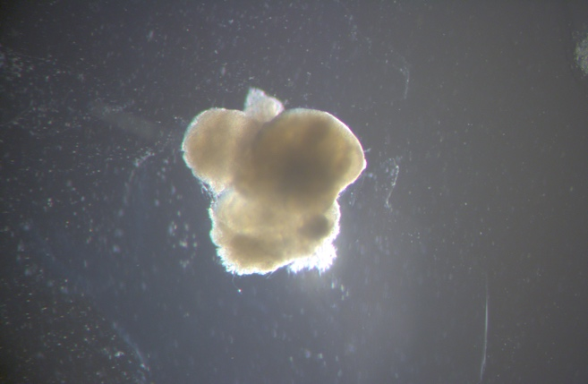
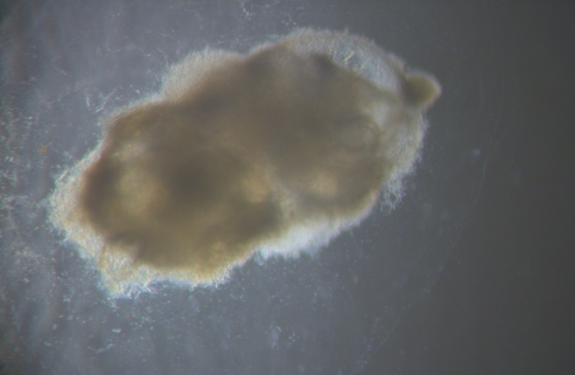
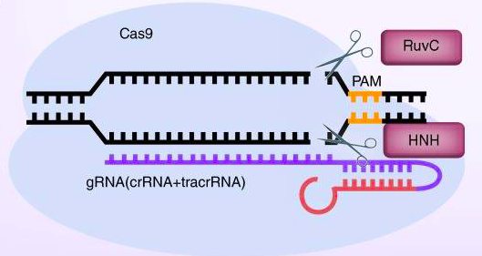
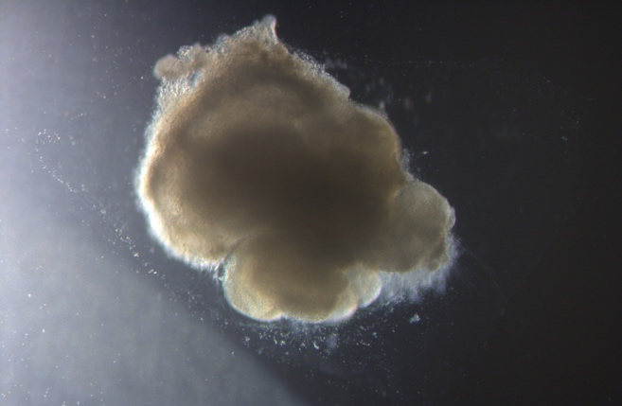
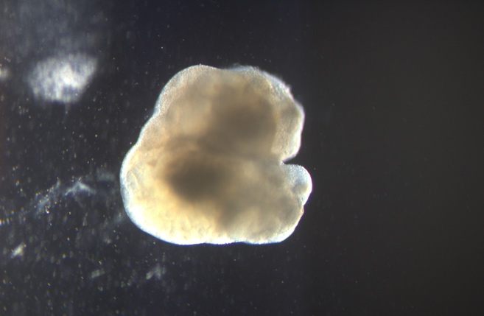
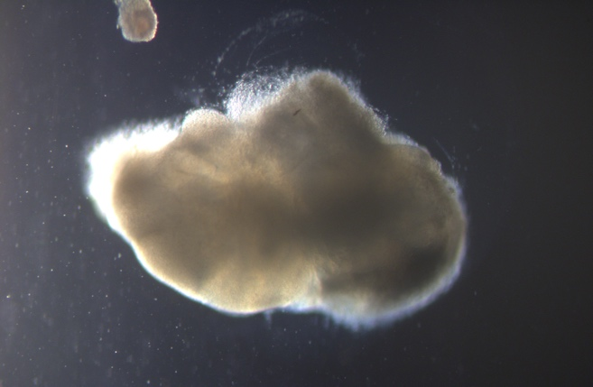
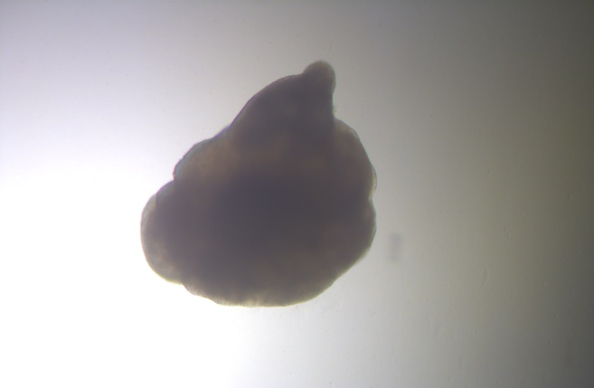
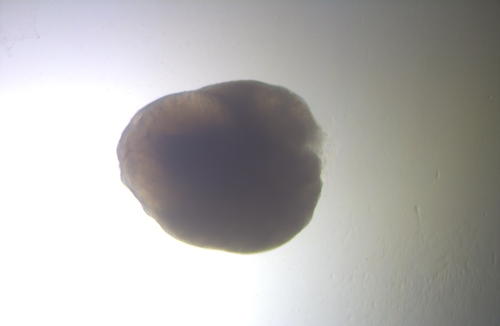
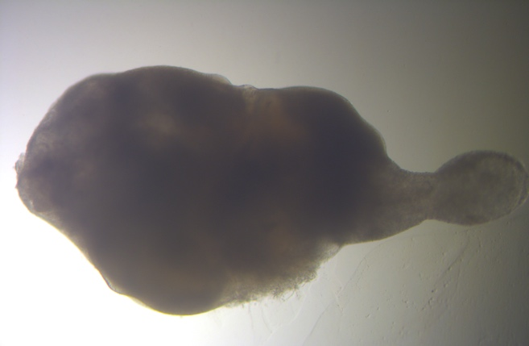
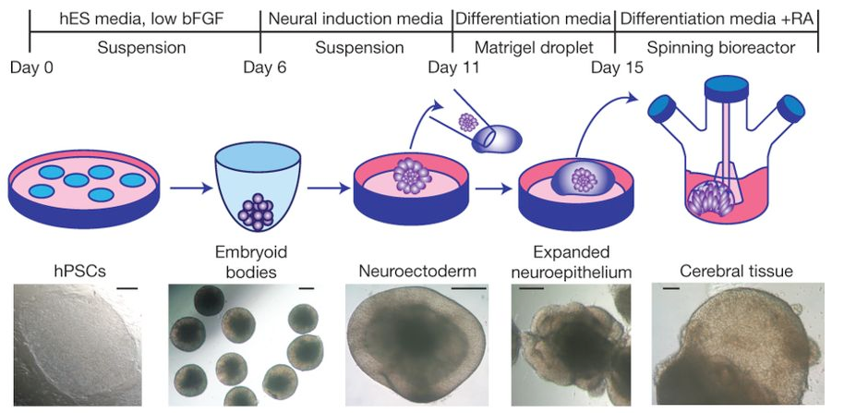
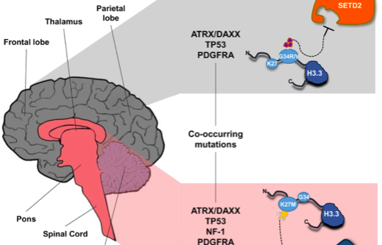
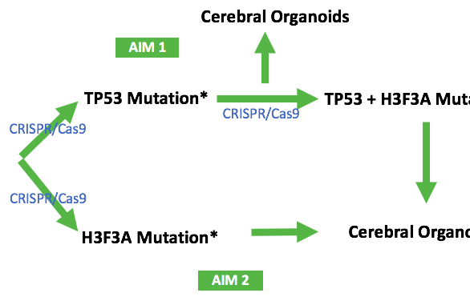





A novel model of pediatric glioma of H3F3A mutant and TP53 mutant cerebral organoids
Shering Torres, Paul Knoepfler
University of California, Davis, School of Medicine.
Institute for Pediatric Regenerative Medicine. Shriner’s Hospital for Children Northern California
Diffuse Intrinsic Pontine Glioma (DIPG)
Background
Overarching Goals/Aims
Analysis of TP53 Mutant Growth in
Cerebral Organoid
Conclusions
Larger sizes of TP53 mutant hiPSC of cerebral organoids compared to its non-mutated counterparts may show early signs of our intended model formation – we plan to develop an in-vitro 3D model for DIPG which can serve as a research tool.
Diffuse Intrinsic Pontine Glioma (DIPG) is an incurable childhood brainstem tumor, affecting 200-400 children in the United States per year. Once diagnosed, the only known treatment is radiation, with death occurring in <12 months of initial diagnosis.
TP53 mutant hiPSCs show greater growth during cerebral organoid differentiation phase compared to control cell lines.
Wild-Type
Mock Control
TP53 Mutant
Future Directions
Resection is impossible due to its location and infiltrative growth. Chemotherapeutic agents are ineffective due to poor understanding of underlying molecular and cellular biology, and lack of in-vitro and in-vivo models for testing.
Figure 2. Aims. *includes mock controls – transfected without specific guides.
Day 10
Analyze the molecular biology of TP53 mutant hiPSC for cell cycle, proliferation, apoptosis, differentiation, drug sensitivity, and expression of cancer markers
H3F3A mutation on hiPSC
Experimental Design
(1) Use CRISPR/Cas9 to introduce co-mutations of TP53 and H3F3A in hiPSCs.
Day 15
CRISPR/Cas9: Cells are transfected with a plasmid that codes for the guide RNA, Cas9 protein, and a selection marker for puromycin resistance and/or hygromycin resistance.
References
Mathew, Rutka, 2018
Day 19
Yeun B., Knoepfler P. Histone H3.3. mutations: a variant path to cancer. Cancer Cell, 2013.
Chen K., Knoepfler P. To CRISPR and beyond: the evolution of genome editing in stem cells. Reg Med, 2016
Lancaster, et al. Cerebral Organoids model human brain development and microcephaly. Nature, 2013
Johung T., Monje M., Diffuse Intrinsic Pontine Glioma: New Pathophysiological Insights and Emerging Therapy Targets. Current Neuropharmacology, 2017.
In patients with DIPG, genetic mutations of gain-of-function K27M of Histone H3.3 gene (H3F3A) and loss-of-function P53 gene (TP53) frequently co-occur.
Day 23
Day 27
Figure 3. CRISPR/Cas9 Schematic. Chen and Knoepfler, 2016.
Figure 5. All images taken at 4x magnification
(2) Compare growth of these mutated hiPSCs in the form of cerebral organoids
Acknowledgements
Figure 1. Distribution and characteristics of H3.3-mutated gliomas model. Yeun, Kneopfler, 2013
Rotation
Clinical and Translational Science Center (CTSC) for sponsoring the TL1 Training Program
Lab colleagues, especially Dr. Magda Cichewicz for her guidance and willingness to teach me.
Jacob Loeffler, previous TL1 scholar, for initiating project and completing the first mutation.
Dr. Paul Knoepfler for continued mentorship and accepting me into his laboratory.
Hypothesis
Combined TP53 and H3F3A mutations in human induced pluripotent stem cells (hiPSCs) will be a good model for DIPG development.
Figure 6. Area of cerebral organoids standardized to wild-type control.
Figure 4. Brain organoid development timeline, Lancaster 2013.

