Slide 1

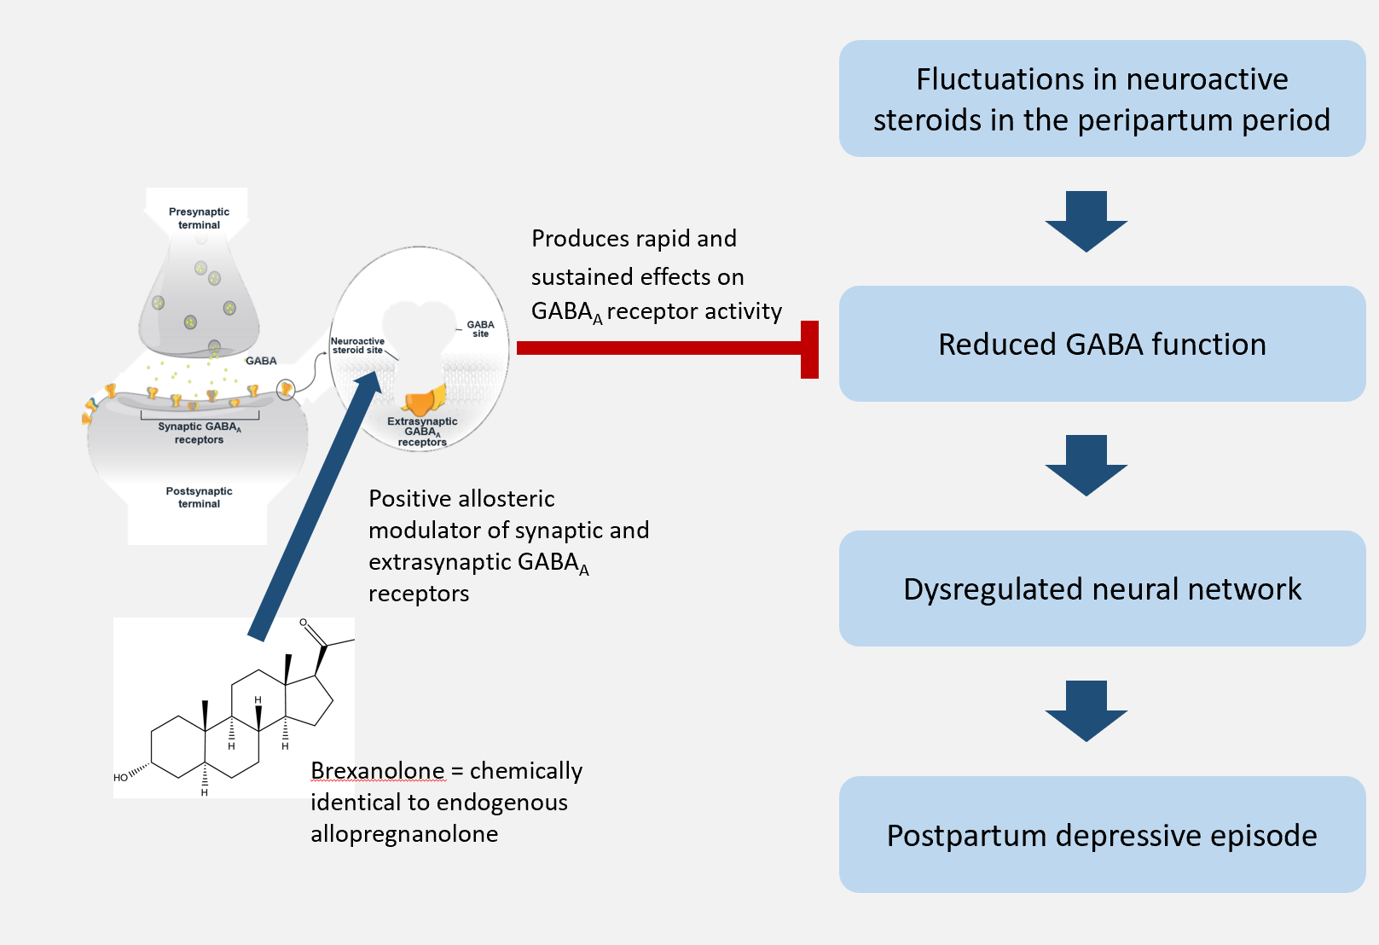
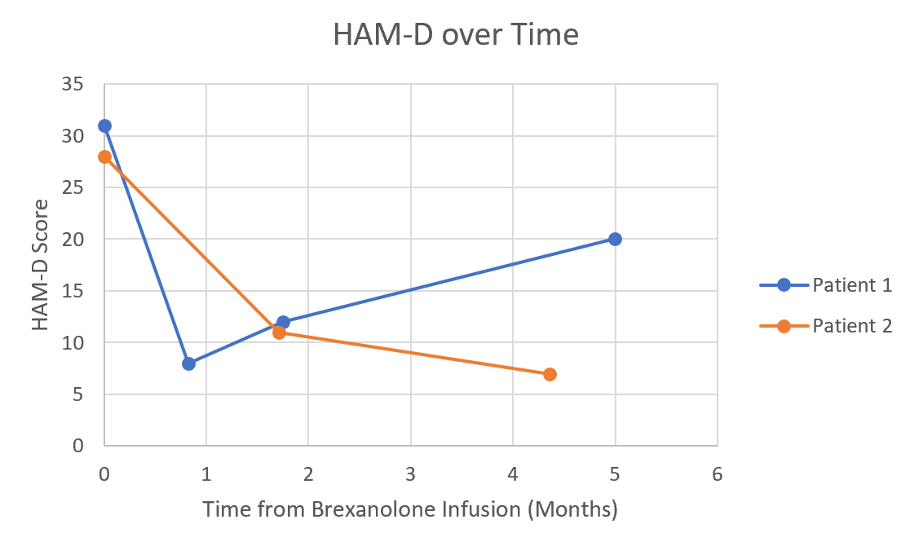
Efficacy of Brexanolone in the Treatment of Post-Partum Depression
Rachel E. Bent, Herman L. Hedriana, MD, Shannon Clark, MD
From the School of Medicine (Bent) and Department of Obstetrics and Gynecology (Dr. Hedriana and Dr. Clark), UC Davis Health, Sacramento, CA
Background
Objective
Results
Conclusions
Post-partum depression (PPD) affects 1 in 8 women
PPD has consequences for both mother and child
  Negatively impacts breastfeeding, sleep routines, well-child visits, vaccinations, and safety practices
Until recently, the primary treatment for PPD has been psychotherapy and antidepressants
Brexanolone (generic for Zulresso) was FDA approved March 2019 and is the first drug approved specifically for PPD
  60-hour IV infusion
  Neurosteroid and analogue of allopregnanolone
  This medication offers a novel approach to treatment of postpartum depression
Patient Demographics
Age, years
Mean | 31 years
Time from delivery to brexanolone infusion, weeks
Mean | 15.9
Range | 14.7 – 17.0
Ethnicity, n (%)
Hispanic/Latino | 0 (0)
Not Hispanic/Latino | 2 (100)
Declined to state | 0 (0)
Parity, n (%)
Nulliparous | 1 (50)
Parous | 1 (50)
Barriers to receiving brexanolone infusion:
  Inpatient hospitalization
  Insurance authorization
HAM-D decreased for both patients and stayed below baseline for >30 days
No significant side effects noted during infusion
One patient who relapsed 5 months after the infusion had major life stressors at the time which may confound findings
Limitations:
  Small sample size
  Limited follow-up period
Brexanolone, the first medication of its kind, may open the door to many more treatment options in the future
Track symptoms of depression in women with post-partum depression every month for 6 months following brexanolone infusion
Materials and Methods
UC Davis approved to enroll 6 patients for brexanolone infusion
  2 out of 6 patients have been administered the medication
Patients recruited from Dr. Clark’s OB/GYN clinic and/or CONNECTED group
Patients admitted to Labor & Delivery for 60-hour IV brexanolone infusion. Patients were monitored using REMS for:
  Sleepiness
  Dry mouth
  Loss of consciousness
  Flushing of skin or face
Follow up: Patients' symptoms of depression will be evaluated every month for 6 months
Outcome measure: Hamilton Depression Rating Scale (HAM-D)
  Scoring based on 17-item scale
  0-7: No Depression
  8-16: Mild Depression
  17-23: Moderate Depression
  >24: Severe Depression
  52 = Max score
Both patients received brexanolone for a diagnosis of post-partum depression with anxious distress
Patients continued their home psychiatric medications
Neither patient experienced medication side effects during the infusion period
Both patients reported subjective improvement in symptoms during the infusion
  Improvement in mood
  Decreased anxiety
References
Scott, L. J. (2019). Brexanolone: first global approval. Drugs, 79(7), 779-783.
Kanes, S. (2018). Brexanolone for Treatment of Postpartum Depression (PPD) [PowerPoint slides]. Retrieved from https://www.fda.gov/media/121351/download
Kose, S., & Cetin, M. (2017). Brexanolone: an allosteric modulator of GABA-A receptors in the rapid treatment of postpartum depression.
Michael W. O'hara & Annette M. Swain (1996) Rates and risk of postpartum depression—a meta-analysis, International Review of Psychiatry, 8:1, 37-54, DOI: 10.3109/09540269609037816
Field, T. (2010). Postpartum depression effects on early interactions, parenting, and safety practices: a review. Infant Behavior and Development, 33(1), 1-6.
FDA approves first treatment for post-partum depression. (2019, March 19). Retrieved June 1, 2019, from https://www.fda.gov/news-events/press-announcements/fda-approves-first-treatment-post-partum-depression
Han, D. (2019, March 20). Zulresso Approved as First Treatment for Postpartum Depression. Retrieved June 1, 2019, from https://www.psychiatryadvisor.com/home/topics/mood-disorders/depressive-disorder/zulresso-approved-as-first-treatment-for-postpartum-depression/
Brexanolone has been validated in three clinical trials prior to FDA approval
These studies showed improvement in the Hamilton Depression Rating Scale (HAM-D) up to 30 days after infusion
Acknowledgements
The project described was supported by Sage Therapeutics
Special thanks to Dr. Shannon Clark

