Slide 1


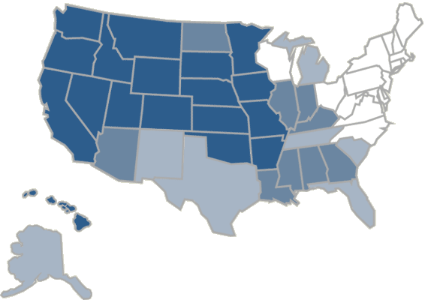
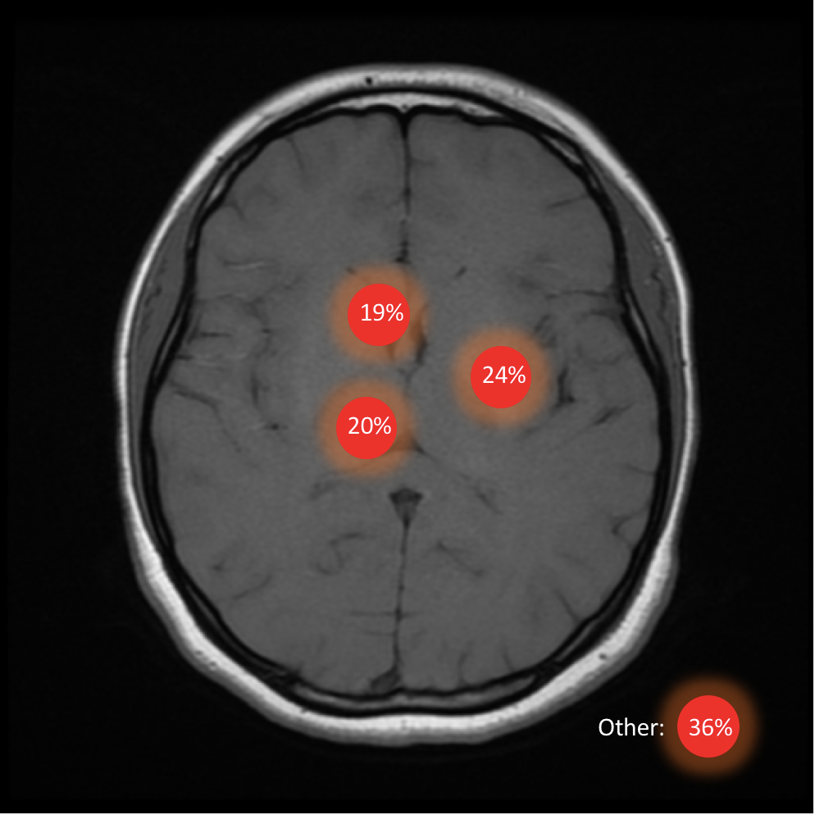
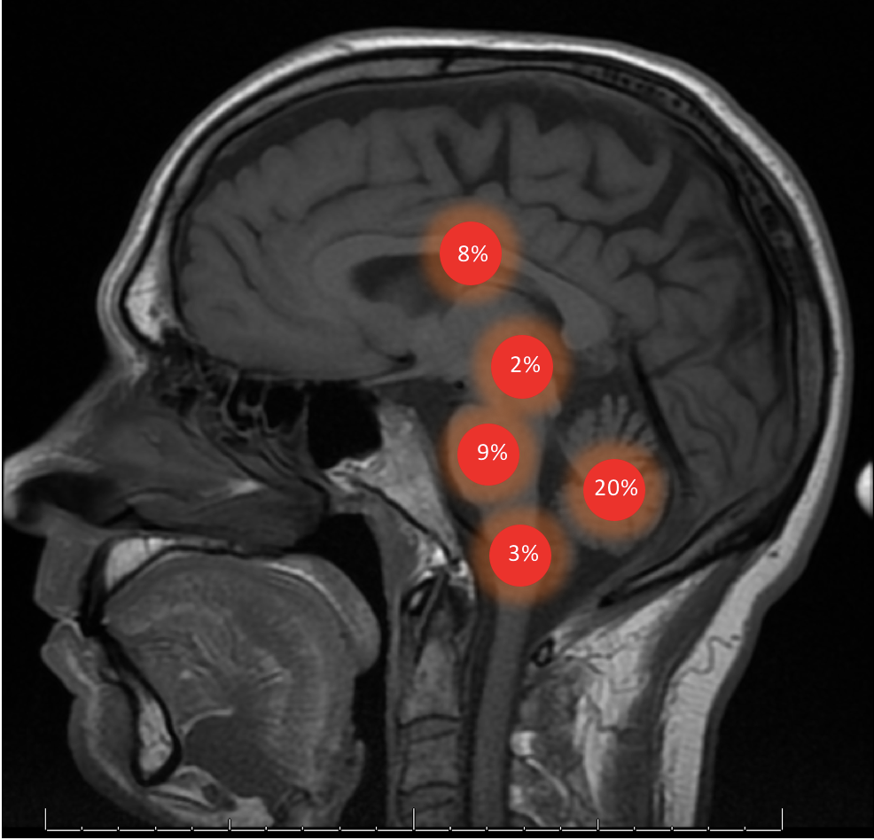
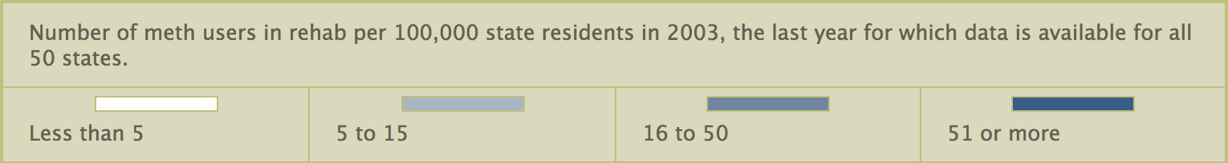
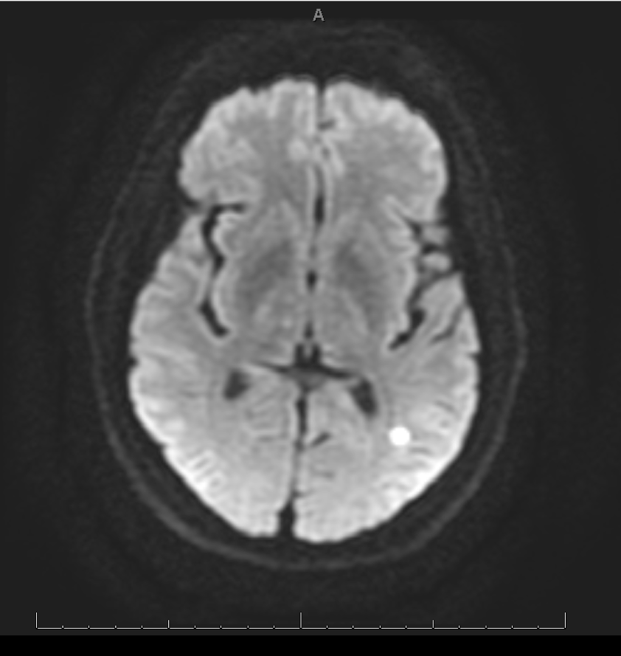
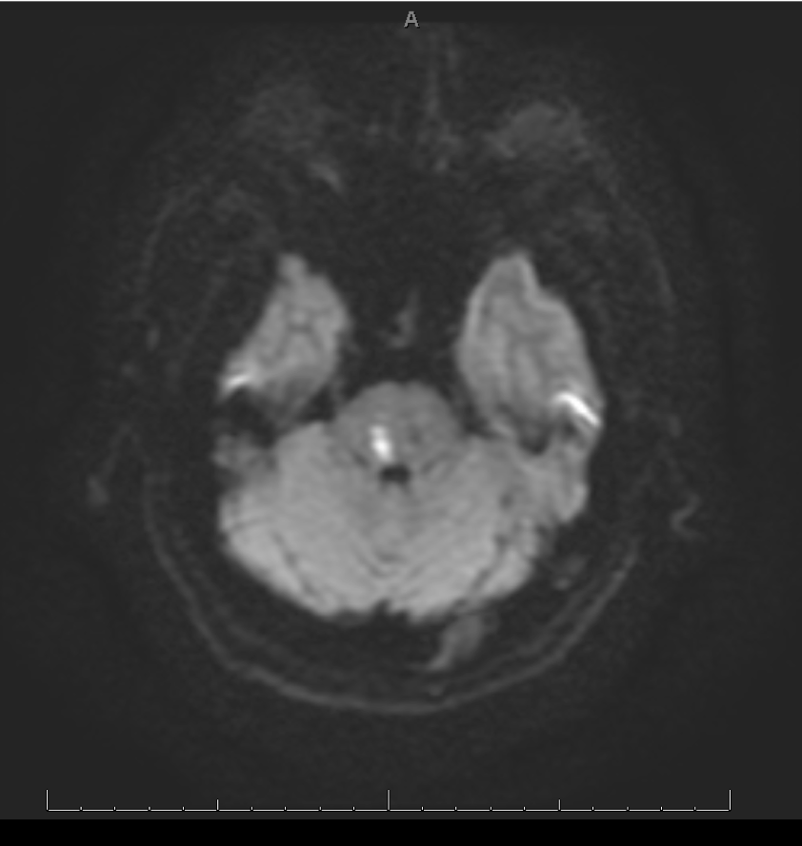
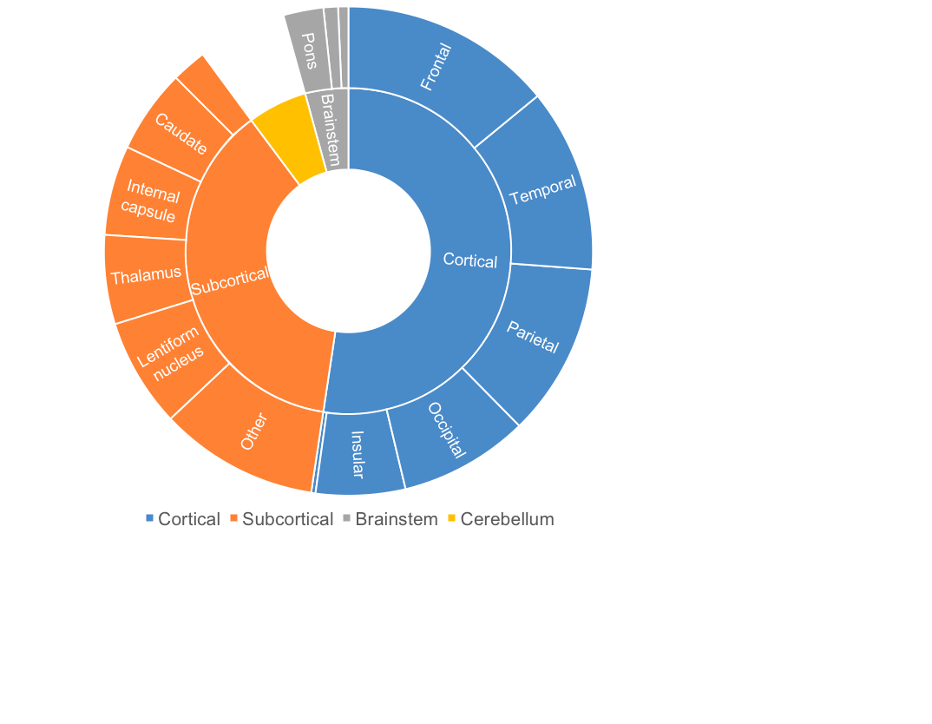
Imaging Characteristics of Methamphetamine-Associated Ischemic Strokes
Nhayoung Hwang¹, Sandeep Walia, MD², Kwan Ng, MD, PhD³, Alan Yee, DO³
University of California, Davis School of Medicine¹, Department of Neurology, Stanford University², Department of Neurology, University of California, Davis³
INTRODUCTION
Table 1. Demographics, N=90 | n | %
Age, average in years | 55
Sex
Male | 62 | 69
Female | 28 | 31
Race/Ethnicity
White | 42 | 47
Black/African American | 22 | 24
Hispanic/Latino | 7 | 8
American Indian/Native American | 0 | 0
Asian | 7 | 8
Pacific Islander | 1 | 1
Other | 11 | 12
Stroke Etiology
Methamphetamine (meth) is a highly addictive stimulant with harmful effects that lead to cardiovascular disease and stroke.¹ Rates of meth use have been growing with an estimated 24 million users worldwide as of 2015.² Despite a strong association between meth use and increased cerebrovascular risk,³ detailed descriptions of clinical and neuroradiologic characteristics in larger cohorts are lacking.
Meth use in the United States⁴
Figure 4. TOAST Criteria
Lesion Characteristics
CONCLUSIONS
ACA: 10%
Meth-associated acute ischemic stroke is a multicultural problem
Although small vessel vasculopathy is suspected in most, a significant proportion is due to proximal embolic sources
Clinical outcome was poor; long-term care required in most and nearly 1 in 6 died during their hospitalization
Next steps of the study include comparing this sample with non-meth-associated ischemic strokes to identify significant differences in patient and imaging characteristics.
MCA: 71%
Figure 2. Distribution of lesions
Sacramento, CA
PCA: 26%
Multiple: 30%
OBJECTIVE
Figure 1. Affected vascular territories
To examine the clinical and neuroimaging characteristics in patients with acute ischemic stroke and concurrent methamphetamine use.
Table 2. Acute ischemic strokes, N=90 | n | %
More than one lesion | 51 | 57
Bilateral | 28 | 31
Purely cortical | 6 | 7
Purely subcortical | 28 | 31
Purely brainstem | 4 | 4
REFERENCES
National Institute on Drug Abuse. (2019). Methamphetamine. Retrieved from https://www.drugabuse.gov/drugs-abuse/methamphetamine
Chomchai, C., & Chomchai, S. (2015). Global patterns of methamphetamine use. Current Opinion in Psychiatry,28(4), 269-274. doi:10.1097/yco.0000000000000168
Westover, A. N., Mcbride, S., & Haley, R. W. (2007). Stroke in Young Adults Who Abuse Amphetamines or Cocaine. Archives of General Psychiatry,64(4), 495. doi:10.1001/archpsyc.64.4.495
PBS. (2006, February). Map: The Reach of Meth. Retrieved from https://www.pbs.org/wgbh/pages/frontline/meth/map/
MATERIALS & METHODS
Case courtesy of Assoc Prof Frank Gaillard, Radiopaedia.org, rID: 37605
Single-center retrospective analysis
Consecutive adults admitted in 2016 to 2019 for acute ischemic stroke and meth-positive toxicology
Figure 3. Subcortical lesion distribution
Patient Discharge Dispositions
Patient Example
Table 3. Disposition, N=92* | n | %
Home | 48 | 53
Rehab | 8 | 9
SNF | 12 | 13
Acute care/outside hospital | 8 | 9
Death | 14 | 15
Left against medical advice | 2 | 2
RESULTS
Multiple subcortical strokes, one in the right pons, another in the left trigone region
Patient Characteristics
Total of 90 patients
Nearly half from underrepresented minority ethnic/racial groups
Patient A
ACKNOWLEDGEMENTS
Thank you to Dr. Alan Yee for his mentorship and guidance as well as Dr. Sandeep Walia, Dr. Miguel Ruvalcaba, Dr. Kwan Ng, and the UC Davis Department of Neurology without whom this project would not be possible.
*Two patients were admitted twice for separate strokes

