Slide 1
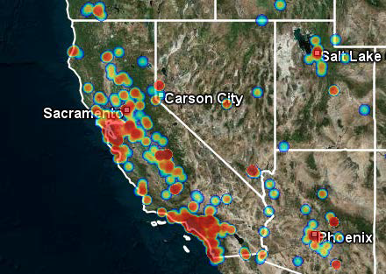
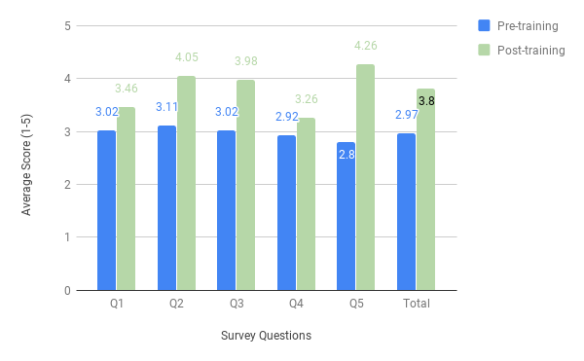
Screening for Sex Trafficking in Labor and Delivery
A Guideline-Based Approach
Madeline Venturino MS4, Leah Timbang MS4, Debra Wright MD, Julie Janke RN, BSN
Background
Human trafficking is defined as the recruitment and movement of individuals—most often by force, coercion, or deception—for the purpose of exploitation. It is important to clarify that trafficking does not have to be movement across international or state borders and it is not consensual commercial sex work.
Human trafficking is a global public health epidemic with an estimated 40 million people trafficked worldwide in 2018. This $150 billion dollar industry places it as the second largest criminal enterprise. More than 49,000 case of human trafficking have been reported to the National Trafficking Hotline in the United States.
Sacramento is a hub for human trafficking. Various factors may contribute to this local crisis: access to multiple interstate highways and an international airport, high incidence of substance use, and large economic gap among the communities. Humans are trafficked for various forms of labor, but this project will focus on the trafficking of humans for sexual exploitation.
Physicians, nurses, and other medical personnel have a unique opportunity to intervene on the cycle of human trafficking. A study of trafficking survivors revealed that 60% of trafficking victims reported a visit to a medical provider during their period of exploitation. The UN reports that 71% of trafficking victims worldwide are female, and more than one in four women became pregnant while being trafficked, making labor and delivery (L&D) departments a logical place to screen for victims of trafficking.
Purpose
The primary aim of this quality improvement project is to increase awareness of human trafficking as a public health epidemic. The success of this project will be assessed through several steps, the first of which will be detailed in this poster. The purpose of this paper is to evaluate a training and process change developed for the labor and delivery department of an academic hospital that involves triage nurses screening for victims of human trafficking.
Figure 1.
Discussion & Further Study
Results of the study showed improved average response for each question and overall average survey response. Average total score of responses improved by 28% (p value <0.0001). The most improvement was seen in question 5 (52%, p<0.0001), which addressed nurses’ knowledge of next steps to take if a trafficking victim is identified. This is an improvement from preliminary data, which showed only 5% improvement in knowledge of next steps after completing training. Questions 2 and 3 showed fair improvement, with 30% and 32%, respectively. These questions evaluated nurses’ overall suspicion for at-risk individuals, and their confidence in asking the screening question.
Questions 1 and 4 saw the least improvement, with 15% and 12% respectively. However, the improvement for question 4 was not statistically significant (p 0.07). Question 1 addressed knowledge of specific patient red flags for sex trafficking, while question 4 evaluated the comfort nurses’ felt in screening for sex trafficking.
According to these results, the training adequately addressed what to do once a trafficking victim is identified. However, more emphasis on knowledge of red flags is needed in future training sessions. Trafficking is a difficult topic to address with patients, and more effort should be put into helping nurses feel comfortable discussing this topic.
Limitations of this study include the potential inconsistency of trainings, which were held at convenient times during nurses’ regular shifts by various instructors. Often, trainings were interrupted by patient care, or expedited due to time constraints. Additionally, there was a process change during data collection in which nurses distributed a short questionnaire instead of verbally asking the screening question, which may have skewed nurses’ comfort or ability in screening for victims as well as the efficacy of screening.
On review of individual responses, several responses appeared as if the participant did not read through each question carefully, based on their response to question 4, which was purposefully posed in a negative direction. This may have skewed the data for question 4.
  Further Study
Because of the process change from verbal/face-to-face screening to screening by written questionnaire occurred midway through the study, it may be valuable to compare the efficacy of these screening methods in identifying victims or making victims feel safe and head.
Future work will also include formal training for social workers in management of trafficking victims once they are identified, since much of this portion of the guideline falls on social workers.
Design & Methods
A guideline originally created to screen for human trafficking in the emergency department (ED) was adapted for the L&D department nursing workflows and approved by a small team of nursing leadership. A brief training was then developed based on the adapted guideline. The training defined the epidemic of human trafficking, introduced the topic of trauma-informed care, then walked through the actual steps of screening for trafficking in the L&D department, and identified the next best steps in management.
Participants of the study included 61 L&D nurses. Participants were asked to fill out an online survey before and after the training to assess any immediate changes in their comfort and ability in screening for trafficking victims. Participants were instructed to agree or disagree with several statements on a 5-point scale (1- Strongly Disagree, 2- Disagree, 3- Neither Agree nor Disagree, 4- Agree, 5- Strongly Agree).
Q1. I am knowledgeable of red flags for victims of sex trafficking.
Q2. I have good suspicion when a patient may be at risk for sex trafficking.
Q3. I feel confident asking questions to screen for sex trafficked victims.
Q4. I feel uncomfortable bringing up the topic of sex trafficking to suspected patients.
Q5. I know what next steps to take if my patient is a victim of sex trafficking.
The post-training survey contained an additional statement assessing the value of the training with the same scale. Responses from Q4 numerically inverted to correct for the negative direction of question.
Performance Data
Figure 2. Comparing average survey responses to pre- and post-training survey questions as well as overall average response.
References
Trafficking in Person Report. US Department of State. June 2019.
“Report: Majority of trafficking victims are women and girls; one-third children.” United Nations Sustainable Development Goals. 22 Dec 2016.
Image obtained from Polaris Project, “The Facts.” 2016.
Oram S, Stock IH, Busza J, Howard LM, Zimmerman C. “Prevalence and Risk of Violence and the Physical, Mental, and Sexual Health Problems Associated with Human Trafficking: Systematic Review. PLoSMed 9(5): e1001224. https://doi.org/10.1371/journal.pmed.1001224
Acknowledgements
University of California, Davis, Department of Obstetrics & Gynecology
University of California, Davis, Department of Emergency Medicine
University of California, Davis, School of Medicine
Dignity Health Family Medicine Residency Program
Sutter Health, Department of Obstetrics & Gynecology
WEAVE, Sacramento

