Slide 1
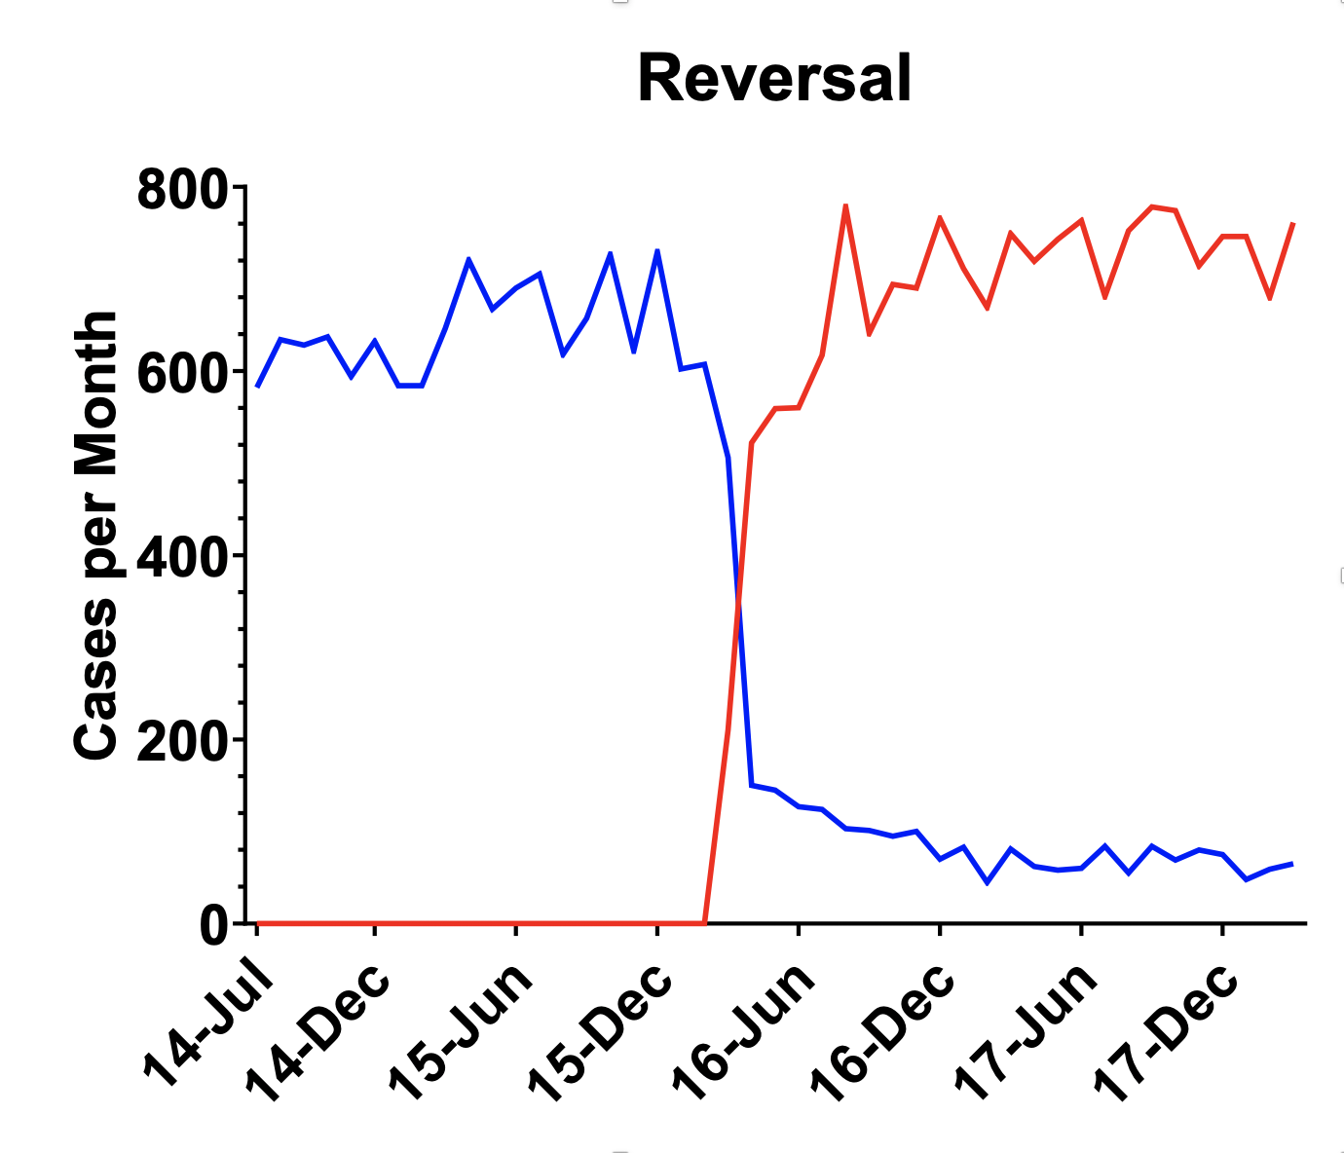


Sugammadex vs Neostigmine: Possible Decrease in PACU Stay
Presenter: Kevin Nguyen
Results
 | PACU Duration (min)
 | Mean | Standard Deviation | n | p-value
Neo: Arth PAV OR | 312 | 317 | 690 | 0.02
Sug: Arth PAV OR | 375 | 393 | 773
Neo: Arth SDC | 123 | 47 | 69
Sug: Arth SDC | 121 | 52 | 87
Neo: Choly | 248 | 280 | 786
Sug: Choly | 258 | 304 | 746
Neo: Bypass | 276 | 193 | 137
Sug: Bypass | 338 | 319 | 137
 | End of Surg to PACU (min)
 | Mean | StD | n | p-value
Neo: Arth PAV OR | 14 | 8.4 | 693
Sug: Arth PAV OR | 13 | 8.3 | 786
Neo: Arth SDC | 7.9 | 4.2 | 69
Sug: Arth SDC | 7.2 | 4 | 87
Neo: Choly | 13 | 9.2 | 744
Sug: Choly | 12 | 7.11 | 746
Neo: Bypass | 14 | 8 | 137
Sug: Bypass | 13 | 7.3 | 140
Sugammadex did not change patient perioperative flow as measured by turn around time from ‘end of surgery’ to PACU, and total PACU stay, when compared to Neostigmine.
Background
Neostigmine – longstanding only choice for reversal of neuromuscular blockade
Incomplete reversal and residual neuromuscular blockade: atelectasis, pulmonary edema, desaturations, postoperative pulmonary complications, and longer hospital stay
March 2016: sugammadex introduced at UCDMC
Sugammadex can rapidly reverse even deep neuromuscular blockade and is associated with fewer adverse events: decreased surgery duration, PACU stay, and overall hospital stay²
This study aims to compare patient flow
-neostigmine versus sugammadex
end of surgery to PACU
total PACU stay
Overall: no significant difference in PACU stay or ‘end of surgery’ to PACU time with sugammadex versus neostigmine
Statistically significant 63-minute decrease in PACU stay in patients with arthroscopies
This is likely a clinically significant difference though possibly due to a wide standard deviation which merits further investigation
Discussion
Our findings - that neostigmine and sugammadex have similar postoperative outcomes - contrasts current literature¹
Data does not suggest relaxant reversals are the rate limiting step in OR departure. Similarly, in the PACU, secondary impacts of relaxants, like hypoxemia, may not be significant or rate limiting
Other reasons include confounding factors --stratify by dose, weight, age/sex, and PACU readiness for discharge vs actual PACU duration. Or, these times are not limited by neuromuscular blockade
Methods
Retrospective study of anesthetic events in UCDMC Pavilion OR and Same Day Surgery Center (SDSC) from July 2014 - March 2018
Arthroscopies, cholecystectomies, and gastric bypasses (n = 3415)
neostigmine vs sugammadex reversal, compared using a grouped t-test analysis
References
Kevin Nguyen BS, University of California, Davis
Neal Fleming MD, PhD, Anesthesiology, University of California, Davis
Carron M, Zarantonello F, Lazzarotto N, Tellaroli P, Ori C. J Clin Anesth. 2017;39:38–44. doi:10.1016/j.jclinane.2017.03.004
Hristovska AM, Duch P, Allingstrup M, Afshari A. Efficacy and safety of sugammadex versus neostigmine in reversing neuromuscular blockade in adults. Cochrane Database Syst Rev. 2017;8(8):CD012763. Published 2017 Aug 14. doi:10.1002/14651858.CD012763
Take a picture to download the abstract

