Slide 1


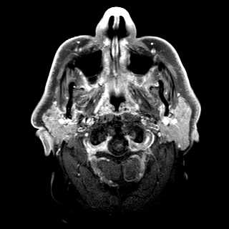
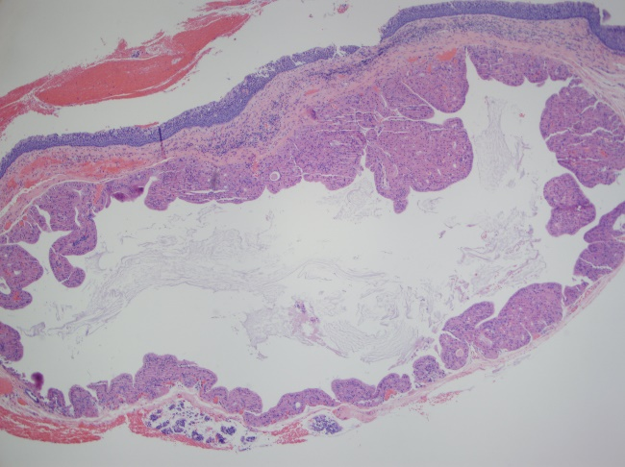
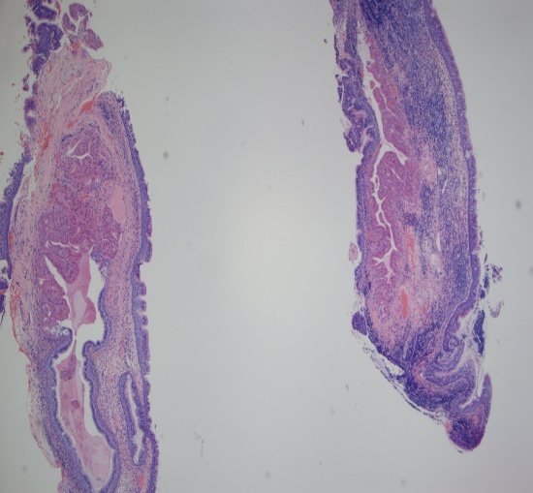
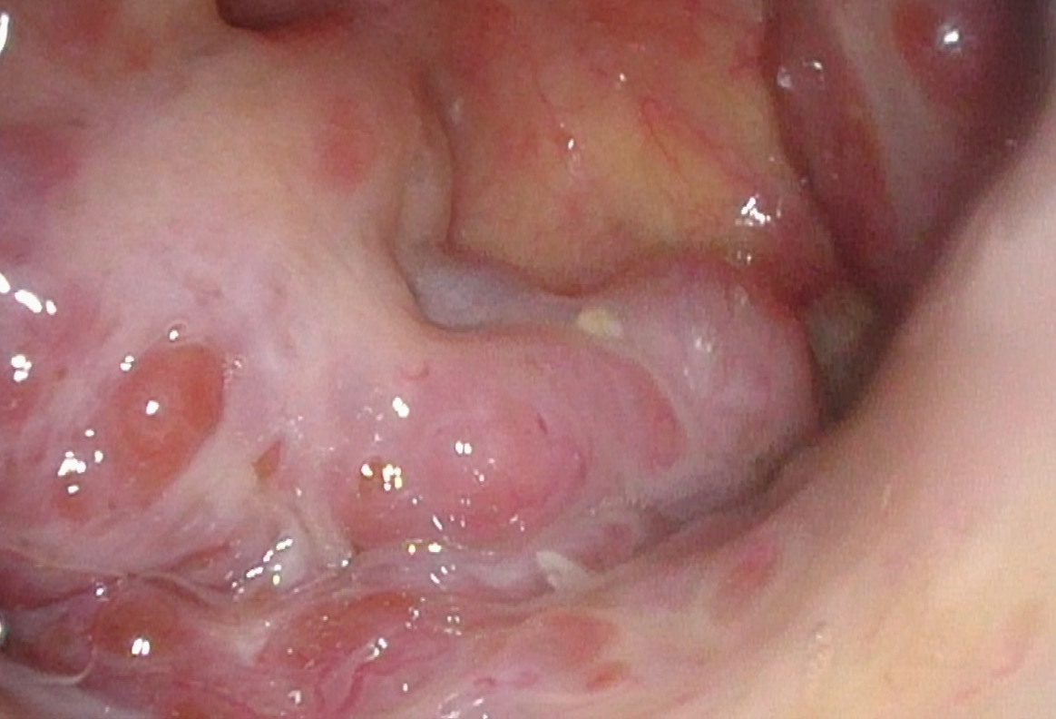
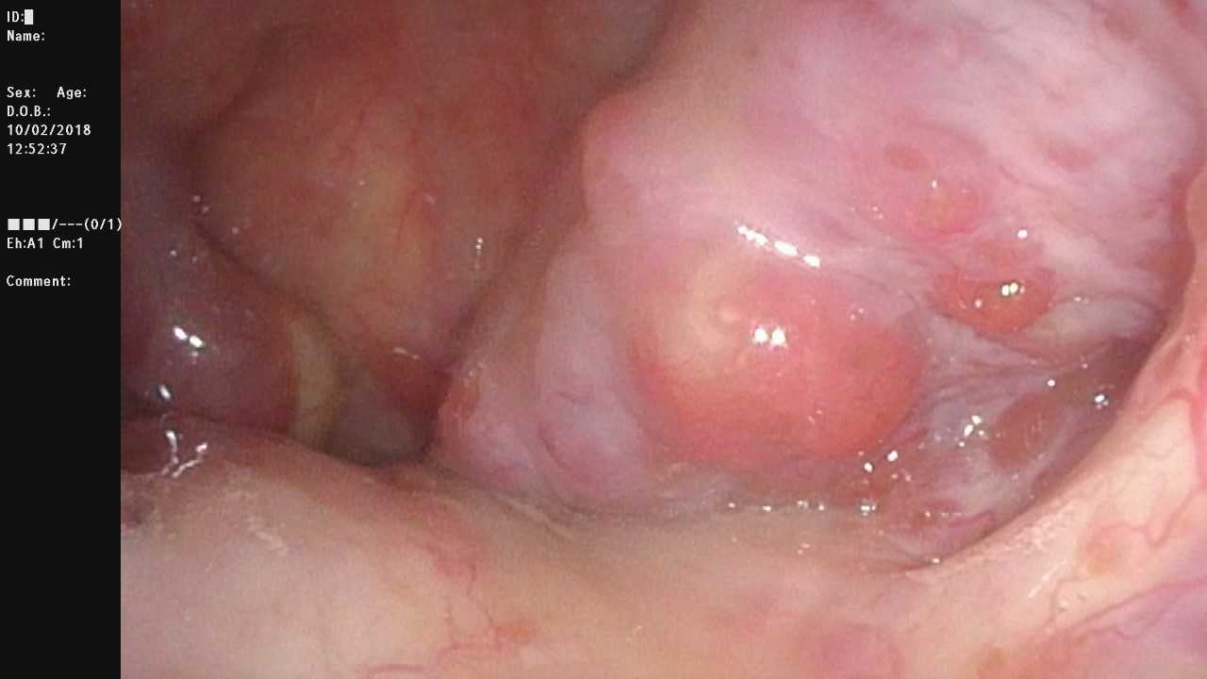
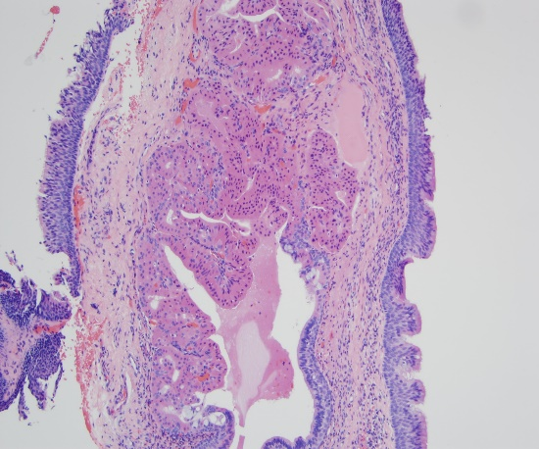
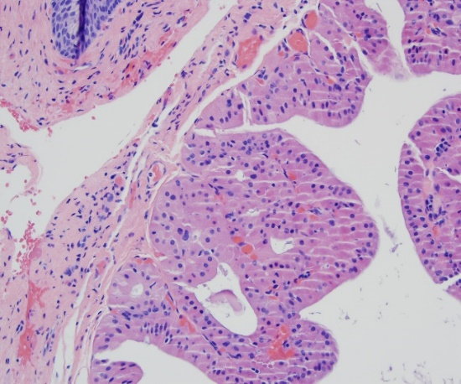
An Unusual Cause of Eustachian Tube Dysfunction: Oncocytic Cysts of the Nasopharynx
Joshua Hwang, BS¹; Raj D. Dedhia, MD¹; Toby O. Steele, MD¹
¹ Department of Otolaryngology, University of California, Davis, Medical Center
Introduction
Images
Discussion
Nasopharyngeal oncocytic lesions are a spectrum of benign lesions that represent a reactive or hyperplastic response to chronic inflammation such as smoking and age-related degeneration.¹ The lesions differ based on location, origin, and presence of cystic and inflammatory components. While these oncocytic lesions are frequently asymptomatic, larger lesions in the nasopharynx can result in significant symptoms such as eustachian tube dysfunction.²
The nasopharynx can give rise to a range of pathologies due to its position at the confluence of diverse embryologic structures of the nasal cavity, pharynx, and skull base. One such pathology is the nasopharyngeal oncocytic lesion. These involve oncocytes, polygonal epithelial cells with abundant eosinophil, granular cytoplasm and round centrally placed nuclei.³ The hyperplastic and pleomorphic mitochondria result in an eosinophilic cytoplasm, and represent a form of cellular degeneration.⁴ Acquired nasopharyngeal oncocytic lesions are thought to arise due to chronic inflammation and cystic degeneration with aging¹. Warthin tumors in particular are strongly linked with cigarette smoking and have a higher incidence in males^{5,6}.
Nasopharyngeal oncocytic lesions are a spectrum of lesions that differ based on the presence of cystic and inflammatory components. Oncocytomas refer to solid oncocytic lesions¹.Oncocytic cysts do not contain an inflammatory component and oncocytic papillary cystadenomas are cystic lesions with an inflammatory infiltrate. Nasopharyngeal Warthin tumors, or papillary cystadenoma lymphomatosum, have a distinct histopathologic appearance with a characteristic bilayered epithelium of oncocytic luminal cells and basal cells that are lined by a lymphoid stroma containing germinal centers⁷. While Warthin tumors are almost exclusively restricted to the parotid gland, extraparotideal sites are thought to arise from metaplasia of minor salivary gland components trapped with submucosal lymphoid stroma^{1,8-11.}
Although nasopharyngeal cysts, of which oncocytic cysts are a subtype, can occur in up to 6% of individuals, it is rare for them to become clinically evident or symptomatic, as was observed in this patient ^{12,13}.
CT imaging of oncocytic lesions will demonstrate mixed solid-cystic lesions. MRI will exhibit predominantly intermediate signal on T1 and T2 weighted images with foci of hyperintensity¹⁴.
Preferred treatment consists of endoscopic surgical excision with removal of the affected salivary gland or mass, and avoidance of environmental irritants. Alternatives include aspiration, incision and drainage of cyst content, or marsupialization, but recurrence is common with these methods^{12,15}. In the case of nasopharyngeal oncocytic cysts, treatment must be balanced with morbidity of surgery, as extensive manipulation can cause scarring near the eustachian tube orifice.
Case Presentation
We report a case of a 67-year-old male with 57 pack-year history of smoking presenting with one year of left-sided hearing loss and aural fullness. Otoscopy revealed a persistent serous middle effusion and globally retracted tympanic membrane. Audiological evaluation was consistent with a sensorineural hearing loss with Type C tympanogram bilaterally. Nasopharyngoscopy demonstrated irregular, lobular, submucosal enlargement of bilateral tori tubarius (Figure 1-2). CT demonstrated no discrete nasopharyngeal masses. MRI with contrast showed cystic lesions within the bilateral tori tubarius (Figure 3). The patient underwent placement of a pressure equalizing tube for his eustachian tube dysfunction and nasopharyngeal biopsy. Histological assessment demonstrated retention cyst of minor salivary gland with cyst lining showing papillary projections lined by oncocytic cells (Figure 4). Due to the location of the lesion, excision was not performed to avoid scarring near the eustachian tube orifice and potential worsening of his eustachian tube dysfunction.
Figure 3. T1 fat suppressed post contrast image which demonstrates hypodense cystic lesions of the bilateral tori tubarius with surrounding isointensity
Patient Outcome
A
B
Given the oncocytic cysts’ diffuse involvement of the tori tubarius and eustachian tube orifices, surgical excision would result in scarring and worsened eustachian tube dysfunction. To manage the patient’s symptoms, a myringotomy with pressure equalizing tube was offered, and he was counseled on tobacco cessation and surveillance with serial nasopharyngoscopy.
Figure 4 (A) Low power view shows sections of an oncocytic proliferation arising within a dilated mucoserous gland, or retention cyst, of the nasopharynx. Cyst lining shows papillary projections lined by oncocytic cells. Nasopharyngeal epithelium is seen overlying the cyst.
(B) Another low power view shows oncocytic proliferation arising within the dilated mucoserous gland of the nasopharynx. The cyst lining shows an abrupt transition from typical mucoserous epithelium to oncocytic cells lining papillary projections. There is no epithelial atypia.
Conclusions
Nasopharyngeal oncocytic lesions exist on a wide spectrum based on inflammatory and cystic components
Large lesions can cause eustachian tube obstruction and chronic otitis media with effusion.
Include oncocytic cysts on the differential diagnosis for nasopharyngeal masses causing eustachian tube dysfunction.
Figure 1.Endoscopic view of nasopharynx with right torus tubarius demonstrating irregular and lobular changes to the submucosal tissue
Figure 2.Endoscopic view of nasopharynx with left torus tubarius demonstrating irregular and lobular changes to the submucosal tissue
C
D
Figure 4 (C) Medium power view shows oncocytic proliferation arising within a dilated mucoserous gland, or retention cyst, of the nasopharynx. The cyst lining shows an abrupt transition from typical mucoserous epithelium to papillary projections lined by oncocytic cells. There is no epithelial atypia. The combination of the papillary oncocytic hyperplasia with an adjacent lymphoid infiltrate can lead to a misdiagnosis of a Warthin’s tumor. (D) High power view shows bland oncocytic epithelium, which in some areas has a bi-layered (arrows) appearance, lining papillary projections into the retention cyst.
Contact
Dr. Toby O. Steele, MD
Assistant Professor
Rhinology and Endoscopic Skull Base Surgery
Department of Otolaryngology-Head and Neck Surgery, University of California Davis
tosteele@ucdavis.edu
Dr. Raj D. Dedhia, MD
Department of Otolaryngology-Head and Neck Surgery, University of California Davis
rdedhia@ucdavis.edu
Joshua C. Hwang, BS
UC Davis School of Medicine
jchhwang@ucdavis.edu
References
1.Benke T, Zitsch R, Nashelsky M. Bilateral Oncocytic Cysts of the Nasopharynx. Otolaryngology-Head and Neck Surgery. 1995; 112(2):321-324.Doi: 10.1016/S0194-59989570256-3
2.Nicolai P, Luzzago F, Maroldi R, Falchetti M, Antonelli AR. Nasopharyngeal Cysts: Report of Seven Cases With Review of the Literature. Arch Otolaryngol Head Neck Surg. 1989;115(7):860–864. Doi:10.1001/archotol.1989.01860310098032
3.Richardson M. Benign Neoplasms of the Salivary Glands. Head and Neck Pathology. 2019; 261-283.e2.Doi: 10.1016/B978-0-323-47916-5.00012-1
4.Lim CT. Oncocytic metaplasia of the nasopharynx. Otolaryngology-Head and Neck Surgery. 1998; 118(3):419. Doi: 10.1016/S0194-5998(98)70330-4
5.Kotwall CA. Smoking as an etiologic factor in the development of Warthin's tumor of the parotid gland. Am J Surg. 1992;164(6):646-7.
6. Teymoortash A, Krasnewicz Y, Werner JA. Clinical features of cystadenolymphoma (Warthin’s tumor) of the parotid gland: A retrospective comparative study of 96 cases.Oral Oncology. 2006; 42(6):569-573.
7. El-Naggar, A., Chan, J., Grandis, J., Slootweg, P. and Takata, T. (2017). WHO classification of head and neck tumours. Lyon: World Health Organization
8.Yeh YA, Baker LL, Wang WJ, Fan K. Nasopharyngeal Warthin's tumor. Otolaryngol Head Neck Surg. 1999;120(6):942-4.
9.Ory M, Eran A. Synchronous parotid and nasopharyngeal Warthin tumor. Head Neck. 2016;38(3):E71-2.
10.Yáñez-barraza KL, Domínguez-malagon HR, Mosqueda-taylor A, Cano-valdez AM, Luna-ortiz K. Synchronic nasopharyngeal and intraparotid warthin tumors: A case report and literature review. J Clin Exp Dent. 2014;6(4):e435-9.
11.Pelucchi S, Bianchini C, Ciorba A, Stomeo F, Ferron A, Pastore A. Simultaneous nasopharyngeal and parotid gland Warthin's tumour: a case report. Acta Otorhinolaryngol Ital. 2015;35(2):129-31.
12.Cardesa A, Slootweg P, Gale N, Franchi A. (2016).Pathology of the head and neck. Springer Verlag Berin Heidelberg. Doi: 10.1007/978-3-662-49672-5
13.Ali MY. Pathogenesis of cysts and crypts in the nasopharynx.
14.Minami M, Tanioka H, Oyama K, et al. Warthin tumor of the parotid gland: MR-pathologic correlation. AJNR Am J Neuroradiol. 1993;14(1):209-14.
15. Lloyd SK, Di Cuffa RA, Seymour FK, Savy LE, Grant HR. Cysts of the fossa of Rosenmüller: report of two cases. Ear Nose Throat J. 2010;89:E19–21.

