Slide 1

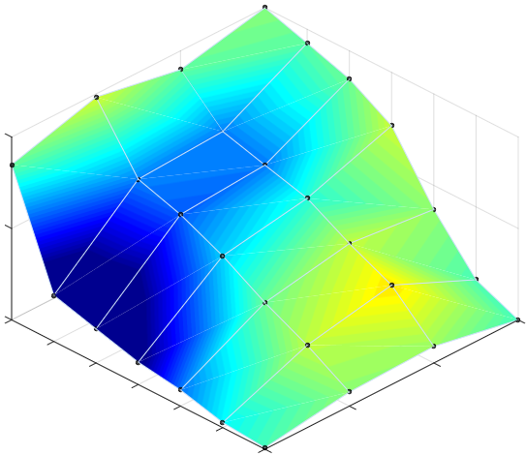
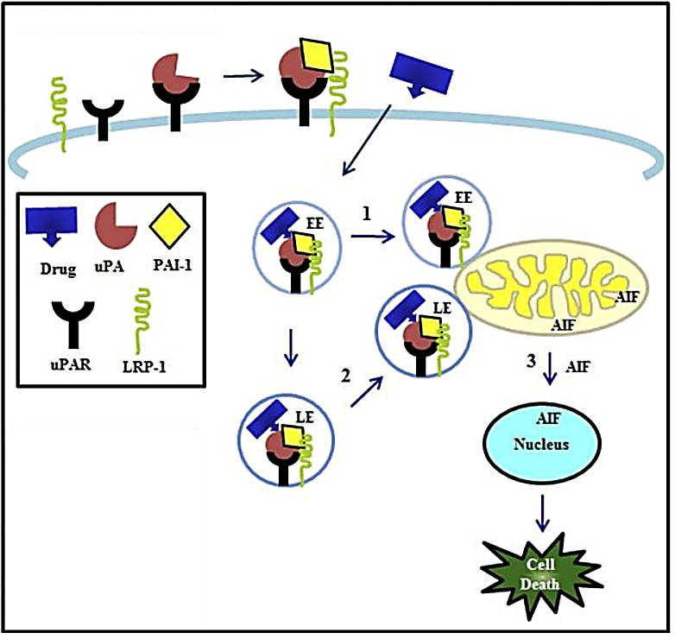
Use of an Amiloride Derivative to Treat Acute Lymphoblastic Leukemia
Masami Ijiri^{1*}, Jan Michael A Lerot^{2*}, Emma Hicks¹, Alex Qiang Lee², Jeremy R Chien ³, Fredric Austin Gorin⁴, Noriko Satake¹
1Department of Pediatrics, 2School of Medicine, 3Department of Biochemistry and Molecular Medicine, ⁴Department of Neurology, UC Davis
Background
Methods
Results (cont.)
Results (cont.)
In 2019, there were about 6,000 new cases of acute lymphoblastic leukemia (ALL) in the US, and ~25% of those were fatal [NIH], highlighting the need for new treatments. Amiloride is a potassium-sparing diuretic. Several studies have identified a potential anti-cancer role for Amiloride and its derivatives in the treatment of leukemia, brain tumors, and breast cancer [Rich IN, Blood. 2000. Pasupuleti N, Mol Pharmacol. 2015. Leon LJ, PLoS One. 2013]. Previous studies by our collaborator Dr. Fredric Gorin’s group, using glioma cells, showed that compound 10357, an Amiloride derivative, demonstrated mis-trafficking of the urokinase plasminogen activator system (uPAS), resulting in mitochondrial depolarization with the release of apoptosis-inducing factor (AIF) causing caspase-independent cell death (Figure 1) [Pasupuleti N, Mol Pharmacol. 2015. Gorin FA, Anticancer Agents Med Chem. 2017].
(1) Live cell (MTS) tetrazolium assay
Leukemia cells (JM1 or Reh B-ALL cell line) were seeded in 96-well plates and then treated with drugs. On the assay day (24 or 72 hours after treatment), 3-(4,5-dimethylthiazol-2-yl)-5-(3-carboxymethoxyphenyl)-2-(4-sulfophenyl)-2H-tetrazolium) (MTS) and N-methyl-phenazonium methosulfate (PMS) were added to the cells for 2-4 hours. The absorbance was measured at 490nm.
(2) Cytotoxic lactate dehydrogenase (LDH) assay
Cells were treated the same as above. LDH released from injured cells was measured in the media (LDH Cytotoxicity Detection Kit, Clontech). Treated cells were normalized to positive control cells treated with 1% triton X-100.
(3) Synergism of combination therapy
Therapeutic efficacy of 10357 was assessed in combination with vincristine, one of the key drugs in the standard chemotherapy for B-ALL (Combenefit software) [Di Veroli GY, Bioinformatics. 2016].
(2) 10357 shows synergism with vincristine in B-ALL cells
In preliminary studies, we tested 10357 in combination with various chemotherapy drugs (data not shown). We selected vincristine (VCR), because it had the highest cytotoxicity in combination with 10357 (results with JM1 are shown in Figure 3). 10357 shows significant synergism with VCR, more importantly at its subtherapeutic (>IC80) doses (Figure 3A and B). We further assessed whether the sequence of the drugs, for instance adding drugs 24 hours apart, would make a difference in their synergism. The results are not conclusive (Figure 3C and D). We also observed similar results in Reh (data not shown).
(3) 10357 induces caspase-independent cell death in JM1 cells
The cytotoxicity of 10357 was not inhibited by addition of a caspase inhibitor (z-VDA-fmk) (Figure 4), suggesting 10357 causes caspase-independent cell death.
A
*
*
*
B
C
A
10357 and VCR combination
B
Synergy map
Antagonism
Synergy
Figure 4. 10357 induces cytotoxicity in the presence of a caspase inhibitor.
Cells were treated with H2O2 (A, n=4) or 10357 (B and C, n=3) for 24 hours with or without z-VAD-fmk. Cytotoxicity was measured by MTS (A and B) or LDH assay (C). All data are presented as the mean ± SD.
* p<0.05.
100
50
*
*
Control (%)
*
*
0
0
Summary/Next Steps
0
12
0.3
Results
14
16
0.4
10357 (µM)
18
20
0.5
VCR (nM)
C
VCR
0hr
10357
24hr
MTS
72hr
D
10357
-24hr
VCR
0hr
22
MTS
72hr
(1) Amiloride derivative 10357 shows cytotoxicity in two B-ALL cell lines.
(2) 10357 shows synergism with VCR, even at its sub-therapeutic doses.
(3) The cytotoxicity of 10357 seems to be non-apoptosis.
Next steps:
(1) Investigate the mechanism of 10357’s cytotoxicity in B-ALL.
(2) Assess 10357 and its combination therapy with VCR in vivo.
10357 shows cytotoxicity in B-ALL cells
10357 shows cytotoxicity in both JM1 and Reh, with its IC50 of 17µM and 15µM, respectively (Figure 2). These IC50 values are higher than those in glioma cells (5µM).
Figure 1. Drug (10357) targets the intracellular uPAS complex, relocating the EE (1) and LE (2) to perinuclear mitochondrial regions. AIF is released and translocated to the nucleus (3), leading to glioma cell death. EE, LE : early and late endosomes, uPA : urokinase-type plasminogen activator, PAI-1 : plasminogen activator inhibitor-1, uPAR : uPA receptor, LRP-1 : low density lipoprotein receptor–related protein-1
Objective
Figure 3. Combination of 10357 and VCR in JM1
Cells were treated with VCR and 10357 for 72 hours. Concentrations used were 0.3-0.5 nM for VCR and 12-22 uM for 10357 (A, n=3 or 4). A synergy map was created using the data in A (B). Cells were treated with different sequences of VCR (0.5nM) or 10357 (10µM) (C and D, n=2). All data are presented as the mean ± SD. * p<0.05.
Acknowledgements
To determine the therapeutic role of 10357 in B-cell type ALL (B-ALL)
Figure 2. Cytotoxicity of 10357 in B-ALL cell lines JM1 and Reh.
Cells were treated with 10357 for 72 hours and cell viability was measured by MTS assay (n=3). The mean ± SD are presented.
10357 was provided by Dr. Gorin.
*M.I. and J.M.L. contributed equally to this project.

