Slide 1



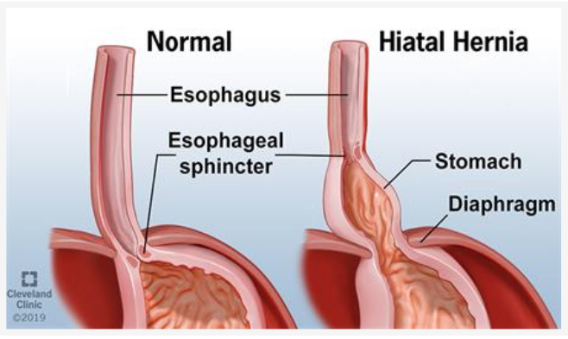
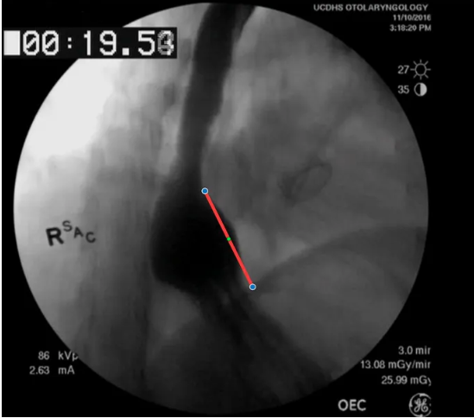
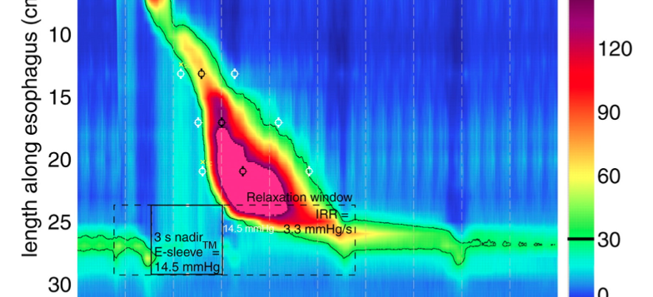
The Association between Hiatal Hernia and Esophageal Dysmotility
Indulaxmi Seeni, B.S., Yuval Nachalon, M.D., Nogah Nativ, PhD, Peter Belafsky MD, PhD
Center for Voice and Swallowing Disorders, Department of Otolaryngology-Head and Neck Surgery, University of California Davis
INTRODUCTION
MATERIALS AND METHODS
CONCLUSIONS
Hiatal hernia (HH) involves the displacement of abdominal organs through the esophageal hiatus to above the diaphragm into the thoracic cavity. The overall prevalence of HH varies between 10-80% and increases with age, higher intrabdominal pressure (ex: obesity), genetic predisposition, congenital defect, and trauma. Sliding HH results in acid and non-acid reflux. Chronic exposure of the esophagus to refluxate can results in dysphagia, difficulty swallowing, due to impaired esophageal motility.
All individuals with a diagnosis of hiatal hernia on video-fluoroscopic esophagrams and ambulatory high-resolution manometry (HRM) between January 2016 and September 2018 were identified.
Patients with known esophageal motility disorders(e.g. achalasia, scleroderma etc.) were excluded.
Patients with hiatal hernia were age and gender-matched to individuals without hiatal hernia.
Manometric and pH measurements were compared between groups.
Patients with hiatal hernia have significantly higher percentages of ineffective esophageal contractions, weaker esophageal body peristalsis and a higher composite pH score than patients without hiatal hernia, regardless of hiatal hernia size.
The findings of this study indicate that there is an association between esophageal motility disorders and hiatal hernias. Chronic GERD in patients with hiatal hernia might contribute to the pathological development of ineffective esophageal motility and should be addressed and treated in patients with HH.
Further research on this topic can contribute to the development of more targeted therapies and treatment for patients suffering from esophageal dysmotility.
RESULTS
REFERENCES
Normal esophageal peristalsis clears bolus into the stomach in less than 15 seconds in normal individuals. Esophageal dysmotility can be caused by the impaired relaxation of upper or lower esophageal sphincters or weak/absent esophageal contraction.
GERD (gastroesophageal reflux disorder) can contribute to the pathophysiological development of esophageal motility disorders, but the role of hiatal hernias in esophageal dysmotility is unclear. The identification of a relationship between hiatal hernias and esophageal motility disorders can significantly aid patients for more targeted treatment and help preserve esophageal motility.
Total participants: 40
Mean age: 60 years (SD 8.6)
60% participants were female
Adler, D. and Romero, Y. (2001). Primary Esophageal Motility Disorders. Mayo Clinic Proceedings, 76(2), pp.195-200.Baylor College of Medicine Blog Network. (2020). Five facts you should know about hiatal hernias. [online] Available at: https://blogs.bcm.edu/2019/07/23/five-facts-you-should-know-about-hiatal-hernias/ [Accessed 11 Feb. 2020].
Cleveland Clinic. (2020). Hiatal Hernia. [online] Available at: https://my.clevelandclinic.org/health/diseases/8098-hiatal-hernia [Accessed 11 Feb. 2020].
Day, J. (2020). Conditions We Treat: Hiatal Hernia. [online] Hopkins Medicine. Available at: https://www.hopkinsmedicine.org/hernia_center/conditions_we_treat/hiatal_hernia.html [Accessed 11 Feb. 2020].
Nativ-Zeltzer, N., Rameau, A., Kuhn, M.A. et al. The Relationship Between Hiatal Hernia and Cricopharyngeus Muscle Dysfunction. Dysphagia 34, 391–396 (2019). https://doi.org/10.1007/s00455-018-9950-3
Patel A, Posner S, Gyawali CP. Esophageal High-Resolution Manometry in Gastroesophageal Reflux Disease. Jama. 2018;320(12):1279. doi:10.1001/jama.2018.8694.
 | Individuals with Hiatal Hernia (n=20) % (SD) | Individuals without Hiatal Hernia (n=20) % (SD) | p-value
Weak or failed swallows | 43% (45) | 10% (23) | 0.006
mean distal contractile integral (DCI) | 1078 (917) | 1760 (931) | 0.025
Distance latency (sec) | 5.5 (4.7) | 7.3 (1) | 0.11
LES integrated relaxation pressure | 7.34 (10) | 7.9 (6.4) | 0.82
Mean composite pH score | 45 (36) | 16 (17) | 0.01
OBJECTIVE
ACKNOWLEDGMENTS AND CONTACT
The goal of this study is to evaluate the association between hiatal hernia and esophageal motility using video-fluoroscopic esophagrams to identify hiatal hernias and ambulatory high-resolution manometry to evaluate esophageal motility.
Thank you to to my mentors Dr. Yuval Nachalon, Dr. Nogah Nativ, and Dr. Peter Belafsky for all your guidance and support!
Please contact Indu Seeni at icseeni@ucdavis.edu if you have any questions.

