Slide 1


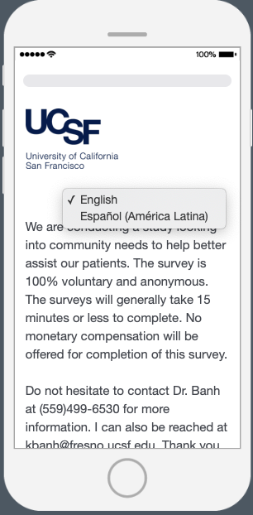
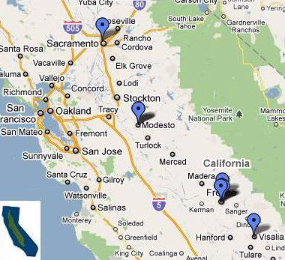
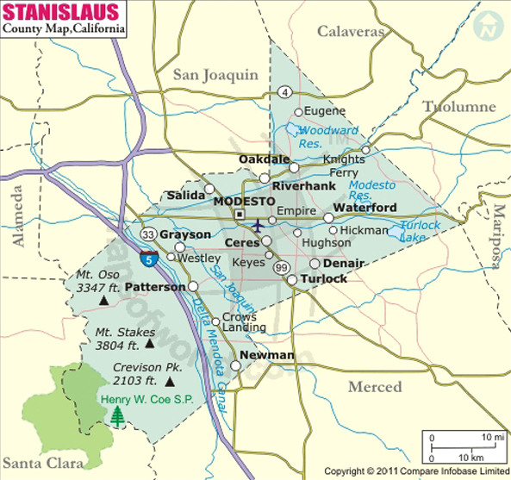
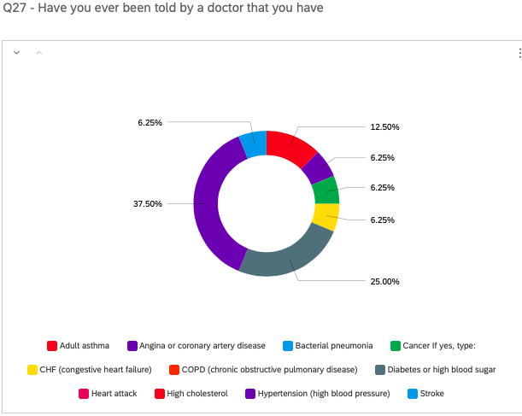
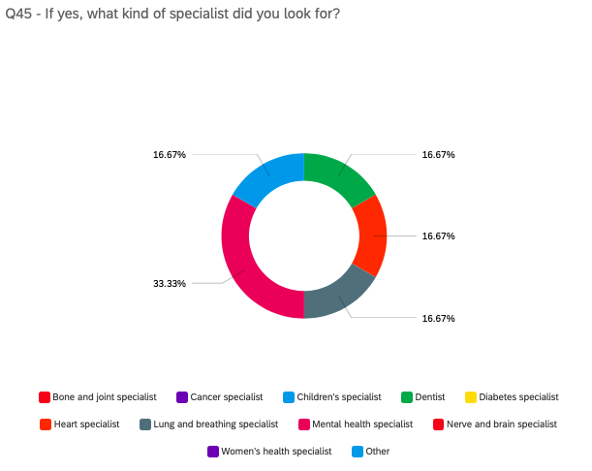
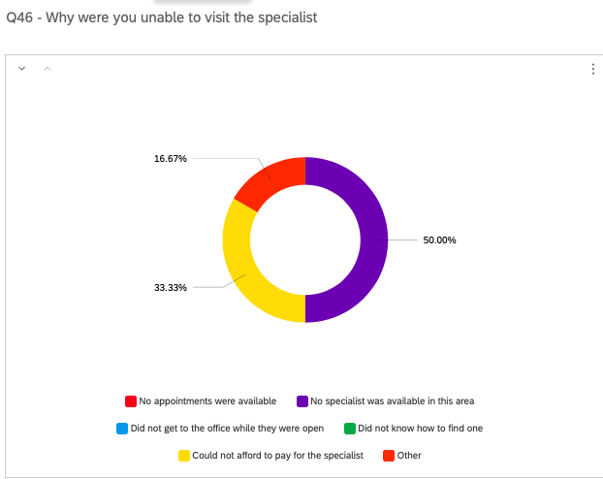
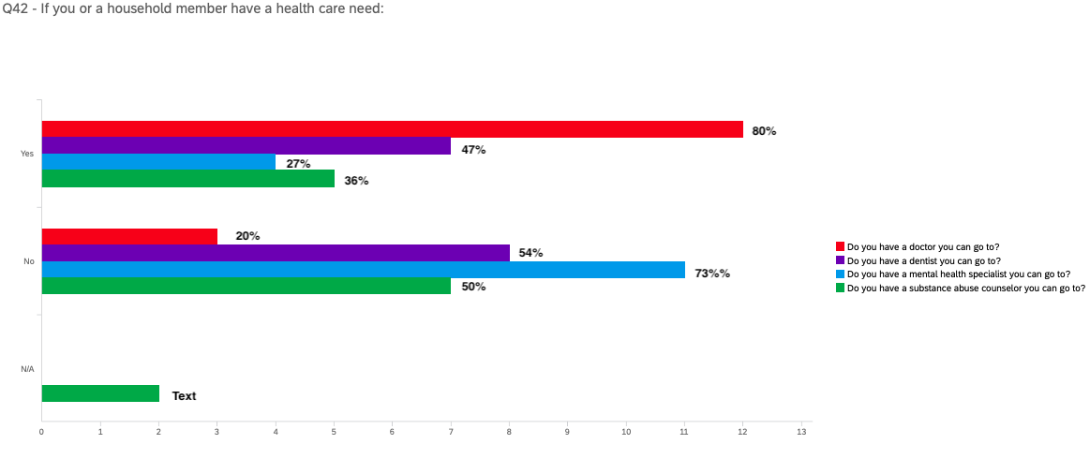
UCSF-Fresno Health and Learning (HeaL) Mobile Clinic: Assessing the continuum of care in Mobile HeaL Clinic service areas
Enid Picart, BS , Jannet Castaneda, BA, Camilo Neacato, BS and Kenny Banh, MD
Background
The Central Valley is home to nearly 6.5 million people, and it is the most underserved patient population in California.¹ The need for core services such as comprehensive healthcare is higher than ever, given that twenty-five percent live in poverty, and over fifty percent are Medicaid or uninsured. Currently, there are 133 active physicians per 100,000 people in the Central Valley in comparison with the California state rate of 222 active physicians per 100,000 people.⁴ Within the next ten years, California is expected to have a shortfall of up to 4,100 primary-care clinicians.^{4,5}
There are approximately 2000 mobile clinics nationwide assisting 6,000,000 people annually.⁹ In addition, mobile clinics are viewed as serving those with a barrier to health care. Nationwide, fifty-three percent of low-income adults don’t trust the health care system, twenty-five percent lack transportation, twenty percent go without care due to inability to pay, and eleven percent are uninsured.¹⁰
The UCSF-Fresno Health and Learning (HeaL) Mobile Clinic was developed to provide free services to the underserved local population. Mobile Clinics are innovative models of healthcare delivery that could help alleviate health disparities in vulnerable populations.⁶ The clinic offers urgent care, preventative health screenings, and initiating chronic disease management particularly to minority groups who often have poorer health and face a higher number of barriers in accessing services.^{6,7} Community based mobile clinics have been useful in uncovering medical needs and eliminating health disparities among the public.⁸
Specific Aims: To identify all community needs for patients who use the UCSF Fresno HeaL Mobile Clinic and to evaluate the differences in health needs providing patients with adequate services.
Discussion: What have we learned from our communities and what we learned regarding barriers to survey completion
Mental health care is the #1 specialist at 33% that is being requested by respondents.
51% of respondents stated that mental health educational services is the most needed in their community.
The annual income of 60% of our patients is less then $20,000 annually but 94% have a form of medical insurance that covers primary care, allowing 80% of respondents to have seen a primary doctor within the last 12 months.
However, per respondents, adult primary care at 27% is the medical services most needed in their communities.
72% of respondents did not see transportation as an issue to accessing care, 30% stated that ability to pay or cost of health care are the greatest limitation to accessing health care.
Full completion of the survey and the willingness of patients to participate remains a barrier to successful survey completion.
Lack of trust within community
68 question survey may be too long to complete during a 15min triage session
Technology has limited completion as limited access to internet in some communities has prevented the ability to administer the survey.
IRB approval limited the administration of the surveys start date until August clinic dates.
Clinic funding through the Legacy Foundation limited the number of clinic dates not allowing for multiple clinic dates to administer survey
Next Steps: Communities, Partnerships & Beyond
This is just the beginning to truly understand the communities we are serving so we must continue to administer survey beyond current allowed study time as this will allow additional survey completion
Work closely with UCSF-Fresno research trained and IRB approved Academic Research Associates ( ARA) students to administer the survey during clinic hours
Continue discussions with foundations to approve clinic funding for additional clinic dates in survey sites.
Consider adopting a shorter survey for needs assessment
Acknowledgements
Thank you to our partners: Cal-Viva, California Rural Legal Assistance, Castle Family Health Centers, Central Valley Community Foundation, Common Space, Kashian, Legacy Health Endowment, Primary Care Research Institute, TransEMotion
Methods
Goal of administering 100 surveys per community sites: Ballico, Turlock, Patterson, Merced, Fresno, and Madera Prospective cross-sectional study which will assess patient’s view on healthcare needs Bilingually adopted the Missouri Hospital Association Completing a Community Needs Assessment Tool- 68 question survey Survey completed anonymous and voluntary during clinic triage Administered in Qualtrics as it will be uploaded to secured iPads where subjects can either complete themselves.
Enid Picart, Student Director of the HEaL Mobile Unit
Is taking the vitals and triaging a local resident while informing her of the importance of diet and exercise improvement for improved cardiovascular health.
Results: UCSF-Fresno HeaL Clinic has held 12 successful community events across the Central Valley averaging 18-28 patients a day during the survey period. A total of 14 surveys were completed from patients age range 28-64. Eleven (79%) of participants that completed the needs assessment were female.
Sydnie Espiritu, an SJV PRIME student
Is helping to screen a local Madera community resident for hypertension during the CalViva “Know Your Numbers” community outreach event.

