Slide 1

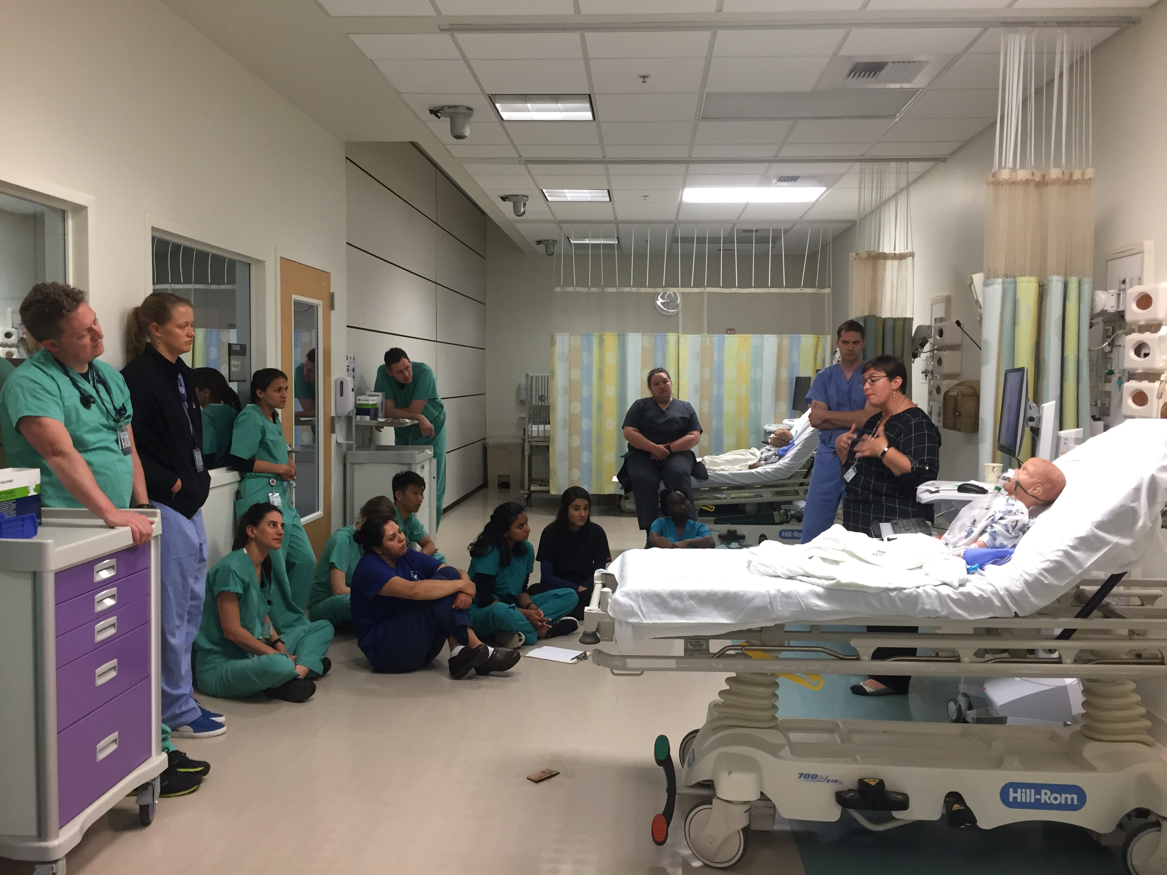
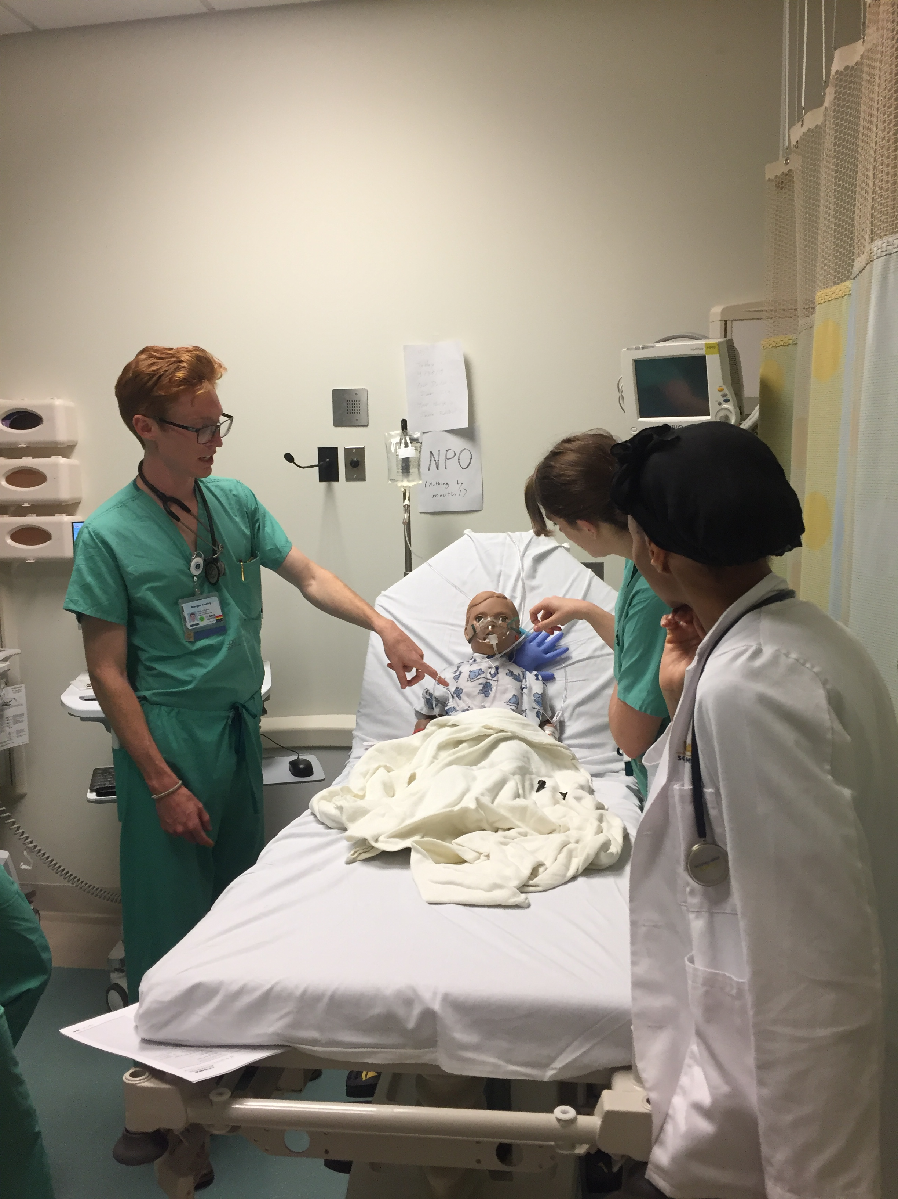
Enhancing Patient Safety in the Pediatric Emergency Department through Simulation
Dale A. Till, Ulfat Shaikh MD, Joanne E. Natale MD, Ian M. Julie MD
University of California Davis School of Medicine
INTRODUCTION
METHODS
Patient safety hazards and adverse events are a significant concern in the United States, especially in the pediatric population
Approximately 13 adverse events occur per 1,000 hospital discharges for children
Increasing situational awareness is an effective intervention to enhance patient safety
Learning how to report identified errors and near misses enables mitigation of real or possible harm
Simulation helps learners and trainees develop situational awareness
Patient care simulation scenarios have demonstrated improvements in learner confidence and their ability to identify safety hazards
A list of 20 high-priority patient safety hazards was created using a modified Delphi technique
Clinical scenario: a five-year-old boy is in the pediatric emergency department suffering from an acute asthma exacerbation
Learners were divided into teams of 3-5, briefed on the scenario, and given 10 minutes to identify hazards
Hazards fell into 5 broad categories: 1. situational safety, 2. privacy and personal information, 3. infection prevention, 4. treatment errors, and 5. electronic health records
Participant makeup:
  102 second year medical students starting clinical clerkships
  91 fourth year medical students transitioning to residency
  15 emergency medicine interns
  13 pediatric interns
Students then watched a 5-minute video on reporting near misses and errors using the UCD incident reporting system, followed by a 15-minute debrief with a facilitator, and completed an evaluation survey.
Fig 3: Students debrief with a facilitator
CONCLUSIONS
The 5 most commonly identified safety hazards identified were:
  patient identification band off (98.1%)
  choking hazards (96.2%)
  another patient's discharge papers at bedside (96.2%)
  food present in room with NPO patient (96.2%)
  slip hazard in room (94.3%).
The five least commonly identified hazards were:
  wrong name and date on whiteboard (69.8%)
  undated IV (49.1%)
  unsecured medications at bedside (47.2%)
  unsigned orders open (33.9%)
  multiple patient charts open in the electronic health record (9.4%)
Next steps include:
  Analyzing data on changes to number of incident reports filed by learners/trainees
  Developing an exercise where participants practice reporting an error themselves
RESULTS
Key outcomes:
  frequency of safety issues identified
  confidence in identifying and reporting hazards, errors and near misses.
Learners rated their overall satisfaction on a 0-10 scale (0= Not at all Satisfied, 10= Very Satisfied).
Mean learner satisfaction scores were high at 8.5 ± 1.5, 7.8 ± 1.7, 8.1 ± 0.9, and 8.9 ± 0.9 for pre-clerkship, pre-residency, emergency medicine interns and pediatric interns, respectively.
Fig 1: Students identify simulated patient safety hazards
OBJECTIVES
To enhance medical student and trainee awareness of and confidence in identifying and reporting patient safety hazards through a brief interactive simulation activity
CONTACT INFORMATION
Fig 2: Confidence in identifying and reporting patient safety hazards
Dale Till, MD Candidate – datill@ucdavis.edu

