Slide 1
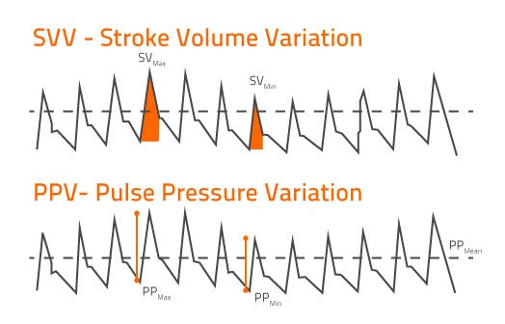

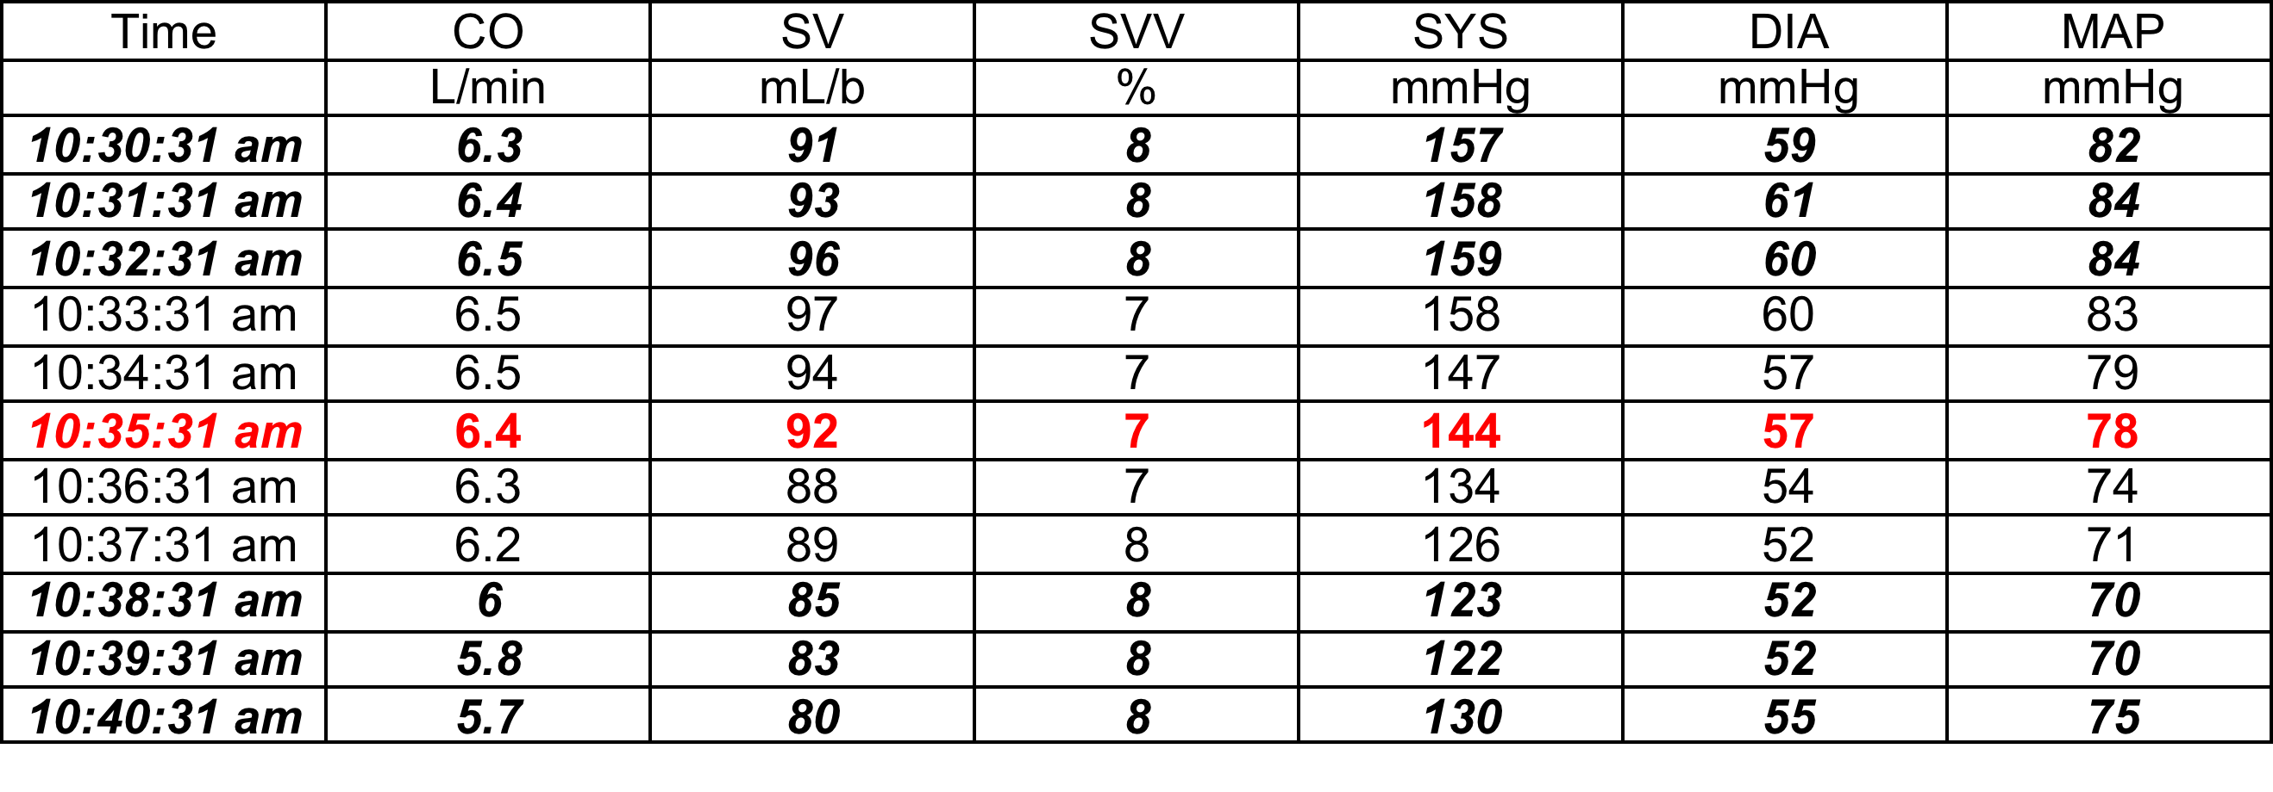
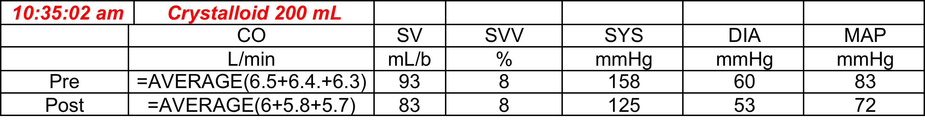
EVALUATION OF DYNAMIC MONITORS FOR THE PREDICTION OF VOLUME RESPONSIVENESS IN PATIENTS WITH AND WITHOUT DIASTOLIC DYSFUNCTION
Presenter: Anastasiia Zhelokhovtseva
At this time, more data is needed to accurately characterize the SVV threshold in patients with left ventricular diastolic dysfunction that would predict fluid responsiveness.
Results
Background
Intra-operative optimization of cardiac function can decrease incidence of complications
Current gold standards to guide optimization are Pulse Pressure Variation (PPV) and Stroke Volume Variation (SVV)
Left ventricular dysfunction is known to predict adverse cardiovascular outcomes (MACE), in-hospital mortality and extra fluid support
Does left ventricular dysfunction alter the threshold for dynamic monitors and their ability to predict volume responsiveness?
To date, 68 patients were recruited for the study
Mean age of 69 ± 10.3 years and BMI of 26 ± 4.6
Patients without DD: SVV threshold of 11.5 at YI of 0.2533
Patients with DD: SVV threshold of 10.5 at YI of 0.2518
Discussion
Methods
IRB approval collected with written consent
Data collected from UC Davis Medical Center at the end of each case
TTE was used to assess DD grading prior anesthesia induction
Ventilation 8ml/kg (IBW), PEEP 5cm H₂O
IV fluids were administered at a basal infusion rate of 1ml/kg (ABW)/hr
As hemodynamic parameters necessitated, crystalloid or colloid was infused
Response to each fluid bolus was recorded by the Flotrac/EV-1000 monitor
Data was analyzed as a 3 minute average with a 2 minute delay pre and post bolus
Comparisons were made between patients with and without DD
ROC analysis using PRISM, Youden’s index (YI) and plot using Microsoft Excel 2019
Current sample size is too small for conclusions
Further data collection and analysis is needed to fully characterize the relationship
General anesthesia might alter the diastolic dysfunction grading
Additional (non-essential) results
References
Monnet, X., Marik, P.E. & Teboul, J. Prediction of fluid responsiveness: an update. Ann. Intensive Care 6, 111 (2016)
Fayad, A., Ansari, M. T., Yang, H., Ruddy, T., & Wells, G. A. (2016). Perioperative Diastolic Dysfunction in Patients Undergoing Noncardiac Surgery Is an Independent Risk Factor for Cardiovascular Events. Anesthesiology, 125(1), 72-91
Swaminathan, M., Nicoara, A., Phillips-Bute, B. G., Aeschlimann, N., Milano, C. A., Mackensen, G. B., … Mathew, J. P. (2011). Utility of a Simple Algorithm to Grade Diastolic Dysfunction and Predict Outcome After Coronary Artery Bypass Graft Surgery. The Annals of Thoracic Surgery, 91(6), 1844-1850.
Raw Data Sample
Anastasiia Zhelokhovtseva, B.S., University of California, Davis
Neal W. Fleming, M.D., Ph.D., Department of Anesthesiology and Pain Medicine, University of California, Davis
David Li, M.D., University of California, Davis
Orode Badakhsh, M.D., University of California, Davis
Esha Lal, University of California, San Diego
Shilpa Reddy, University of Texas at Austin
Take a picture to download the abstract
Sample Calculations

Slide 2
EVALUATION OF DYNAMIC MONITORS FOR THE PREDICTION OF VOLUME RESPONSIVENESS IN PATIENTS WITH AND WITHOUT DIASTOLIC DYSFUNCTION
Anastasiia Zhelokhovtseva, B.S., University of California, Davis
Neal W. Fleming, M.D., Ph.D., Department of Anesthesiology and Pain Medicine, University of California, Davis
David Li, M.D., University of California, Davis
Orode Badakhsh, M.D., University of California, Davis
Esha Lal, University of California, San Diego
Shilpa Reddy, University of Texas at Austin

