Slide 1

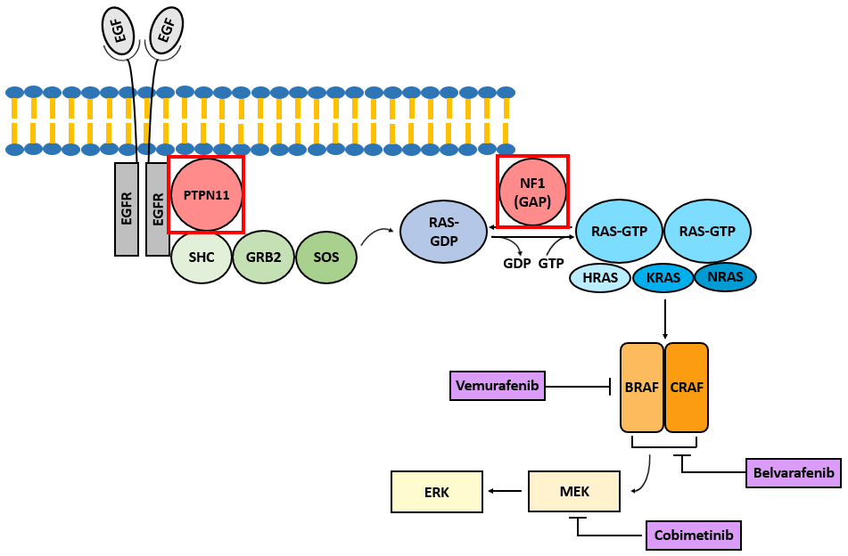
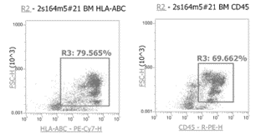
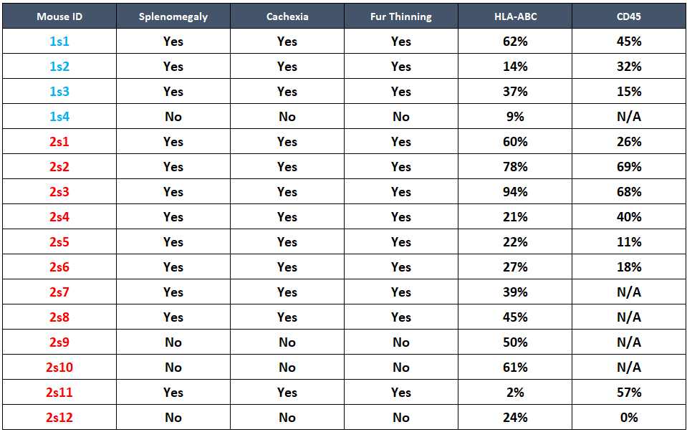
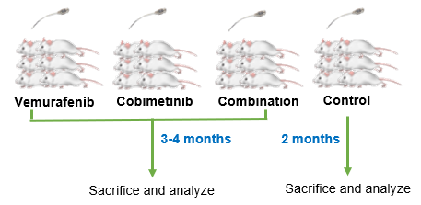
Successful Creation of a Patient-Derived Juvenile Myelomonocytic Leukemia Xenograft Mouse Model to Study Novel RAS Inhibitors
Alex Q. Lee¹, Masami Ijiri², Jan-Michael Lerot¹, Jeremy R. Chien³, Noriko Satake²
¹School of Medicine, ²Department of Pediatrics, ³Department of Biochemistry and Molecular Medicine, UC Davis
Background
Methods (cont.)
Results
Results (cont.)
Juvenile myelomonocytic leukemia (JMML) is an aggressive childhood leukemia which is associated with RAS pathway activation. Currently, the only curative therapy for JMML is allogeneic hematopoietic stem cell transplantation (SCT). However, the median 5-year survival rate after SCT is 64%, with relapse occurring at nearly a 50% rate and generally within a year [Locatelli et al., Blood 2005]. With such poor outcomes and high treatment-related morbidity/mortality, the need for a new effective treatment only increases. In order to develop novel therapies for JMML, an accurate disease model is necessary. To date, there are only 3 reports with successful JMML patient-derived xenograft (PDX) models [Yoshimi et al., Blood 2017; Krombholz et al., Klin Pediatr 2016; Caye et al., Leukemia 2019] and no reports of in vivo RAS inhibitor assessment.
Serial PDX model
(1) Leukemia onset: Leukemia development was confirmed in 3 out of 4 primary mice and in all 12 secondary mice. The affected mice showed symptoms of leukemia development at 16 weeks for the primary mice and 21 weeks for the secondary mice, on average after transplant (Figure 3 and Table 1).
Figure 4. HLA-ABC and CD45 expression on harvested BM cells an example (left) and summary (right)
Figure 1. RAS pathway
RAS inhibitor study
The combination regimen of vemurafenib and cobimetinib has been shown to result in approximately 8% higher 9-month survival rates in melanoma [Larkin et al., NEJM 2014]. We are about to start the proposed experiments in our JMML PDX model. We expect that both drugs will show efficacy and the combination regimen will show enhanced therapeutic efficacy.
using anti-HLA-ABC and anti-human CD45 antibodies. A human leukemia cell line was used as a positive control. Cells harvested from one of the primary mice were serially transplanted to a second generation of 12 mice. Cells were again harvested and confirmed to be of human origin the same way as above.
Vemurafenib and Cobimetinib regimen
Two RAS pathway inhibitors, Vemurafenib and Cobimetinib, were selected as they inhibit different kinases in RAS pathway downstream of the mutated genes in the sample (Figure 1). The drugs were provided by Genentech after MTA placement. Drug regimens were: 1) vemurafenib 50mg/kg, 2) cobimetinib 10mg/kg, and 3) combination by oral gavage once daily for 14 days in a sample of 6 mice per cohort, starting 3 days after leukemia engraftment (Figure 2). Drug vehicle was used for the control group. Outcome will be measured by survival. We will also measure the drug efficacy by phospho-ERK protein expression levels.
Figure 3. Onset of leukemia symptom development
Objectives
Table 1. Primary and secondary xenograft characteristics
To create a JMML PDX model using our recent JMML patient sample.
To assess the therapeutic efficacy of two new RAS inhibitors, Vemurafenib and Cobimetinib, in our xenograft model
Summary/Next Steps
Summary
1) We have succeeded in creating a JMML PDX model.
This PDX model with a rare pediatric cancer will serve as a prototype tool to test new treatments.
Next Steps
Complete our in vivo study. Investigate therapeutic effects of an additional downstream target BRAF/ CRAF inhibitor belvarafenib for vemurafenib- or cobimetinib-resistant JMML clones.
Test these drugs in additional JMML samples.
Identify JMML leukemia stem cells from our PDX model using single-cell sequencing.
Methods
Case characteristics
A 4-year-old Hispanic male presented with fevers, fatigue, weight loss, diarrhea, and facial petechiae for 3 weeks. Molecular testing confirmed a diagnosis of JMML with mutations in PTPN11, ASXL1, and NF1 (Figure 1).
PDX mouse model
Fresh human JMML cells were transplanted into 4 adult NSG mice via bilateral tibial intra-bone marrow (BM) injection (0.5 to 100 million cells per mouse). Upon leukemia development (clinical symptoms), mice were euthanized. Cells were harvested from BM and spleen, and confirmed to be of human origin by flow cytometry
(2) Leukemia engraftment: Harvested BM cells were positive for HLA-ABC and CD45 at various ranges (Figures 4 and Table 1). One out of 4 primary xenografts and two out of 12 secondary xenografts showed engraftment failure. HLA-ABC and HLA-DR positive cells suggest cells of human origin, while CD45 cells suggest leukemia cells.
Acknowledgements
Figure 2. Experiment scheme
Vemurafenib and Cobimetinib were provided following completed MTA by Genentech.

