Slide 1
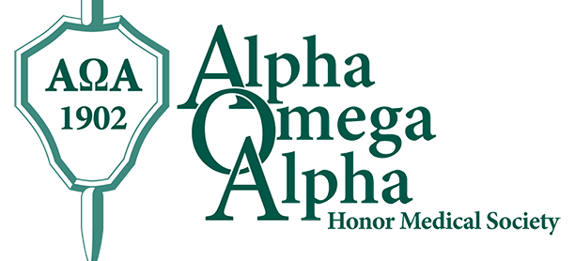
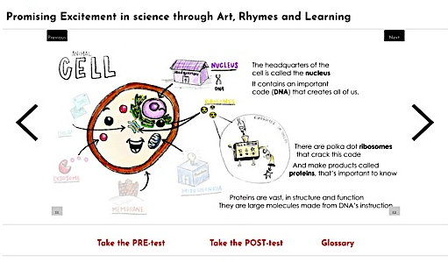
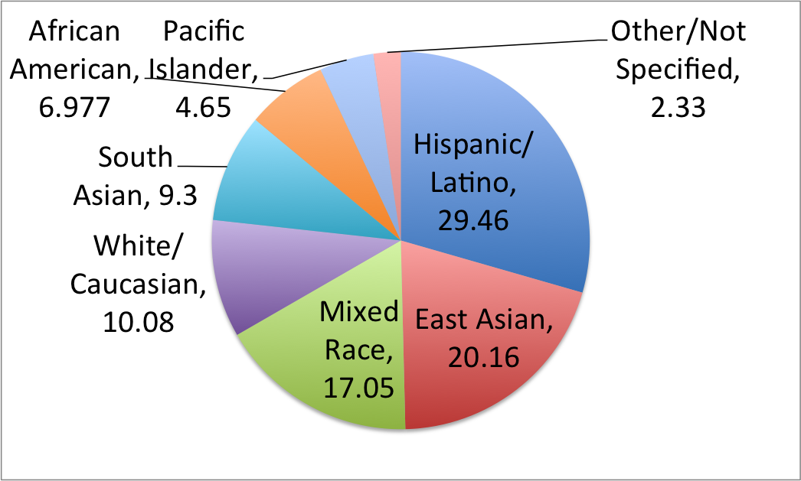
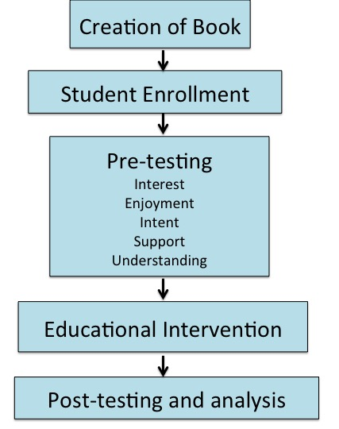
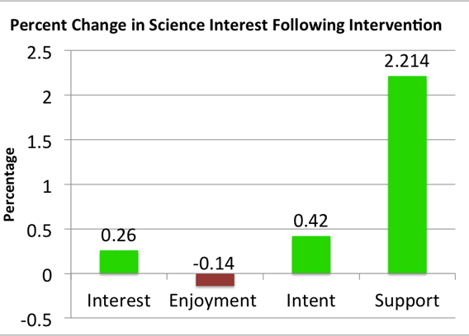
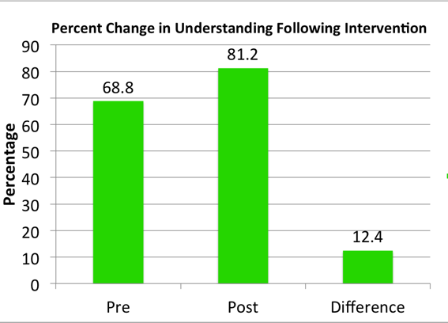
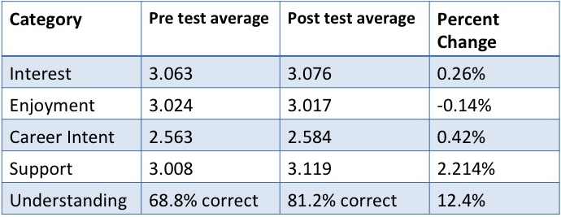
Effects of A Novel Educational Outreach Intervention on Science Interest and Understanding among 8th grade students in Sacramento: Promising Excitement in science through Art, Rhymes and Learning (PEARL)
Aditi M. Trivedi¹, Sarah A. Chen¹, Erin Thorsell², Ulfat Shaikh, M.D.³, Satyan Lakshminrusimha, M.D.³
¹ University of California Davis, School of Medicine, ² San Diego Children’s Discovery Museum, ³ Department of Pediatrics, University of California Davis, School of Medicine
INTRODUCTION
RESEARCH DESIGN, TRIAL AND RESULTS
CONCLUSIONS
Several studies have shown how gender and race stereotypes affect education and students’ perceived abilities, potential and goals (Hyde, 2009) (Litzer, 2014) (Malcolm, 2016). In Sacramento the socioeconomic, ethnic and racial diversity is very pronounced, leading to demographical pattern variations in academic performance, professional interests/opportunities and eventually, the workforce. This childhood educational outreach project seeks to provide early science exposure to 6th - 9th grade students, and to understand the factors influencing science education in our local community. Our team developed a biology and medicine focused poem based illustrated work as a model for motivating lifelong interest in life sciences. Using n=126 students from carefully selected California schools, we are measuring the effects of this learning intervention on students' intent and interest in pursuing science, in order to create an applicable and scalable platform for learning and excite a young audience about their academic potentials and the opportunities in science.
I. Creating the Book
This science educational outreach intervention is an effective method to augment classroom learning and stimulate interest in the science fields. Our results suggest students felt supported and encouraged in their science learning through this intervention, given the 2% change in perceived support. However the intervention does not significantly change, in either direction, students’ interest, enjoyment and intent to pursue further science. Additionally we see that students are able to retain information effectively from the multiple learning modalities presented (rhyming poem, bolded terms, visual illustrations), indicating it serves an effective didactic purpose. Given the large sample size, equal representation of genders, and ethnically diverse population, these results may be applicable to the general student population, bypassing the limitation of single school participation thus far.
Poem content was consistent with the California Department of Education “Next Generation Science Standards for California Public Schools” (Standards MS-LS1-2,3,4,5 and MS-LS3-2, and MS-LS4-5). These concepts involved Inheritance, Biological diversity, Molecular and Organismal Structure and Processes. The Flesch-Kinkaid Score of the completed poem was found to be 8.7. The illustrations (Fig. 2) reflected the educational content in cartoon form, and augmented the material for visual learning and reinforcement for effective recall and retention.
Figure 2: Example page with illustration from book
II. Intervention with Children
A. Results - Participant Demographics
FUTURE DIRECTIONS
N = 126
8th Graders at Natomas Pacific Pathways Preparatory Middle School
52% Female and 48% Male
Ethnically diverse population (see Fig. 3)
Overall: Participants were found to be large in number, high in racial/ethnic diversity and equally representative of gender
Measure and Quantify differences in results among:
  Gender
  Ethnicity
  Grade level
Determine student demographic that benefits most optimally from intervention
Increase Accessibility and Reach via online and print platforms
Multi-school participation
Color illustrations for enhanced visual learning
METHODOLOGY
Figure 3: Participant Demographics - Ethnicities
B. Results – Pre and Post Changes (Fig. 5)
Slight increase in all categories (interest, intent, support, understanding) except enjoyment (0.14% decrease following intervention) (Fig. 4A)
12.4% increase in understanding (Fig. 4B)
2.2% increase in level of perceived support and encouragement in science learning following intervention
ACKNOWLEDGEMENTS
A
B
The authors would like to thank the UC Davis School of Medicine Alpha Omega Alpha chapter for supporting this project, as well as their mentors Dr. Ulfat Shaikh, Dr. Satyan Lakshminrusimha and Dr. Jennifer Plant. The authors are grateful to the teachers and students from California schools that participated in this learning activity.
Figure 4A, B: Changes in interest parameters (A) and science understanding (B) following intervention
57.6% students felt this was a good use of their time
41% felt this activity affected learning and personal growth (20.5% “other” and 38.5% “no”)
Prominent themes for useful/valuable aspects of project:
  “learning” (45)
  “illustrations and rhyming poem” (23)
  “survey and review questions” (5)
REFERENCES
Figure 1: Experiment Overview
Flesch R. A new readability yardstick. J Appl Psych. (1948). 32:221-233. doi:10.1037/h0057532.
Hyde JS. Mertz JE. Gender, culture and mathematics performance. PNAS. (2009) 106(22): 8801-8807.
Litzler E., Samuelson C., Lorah J. Breaking it down: Engineering student STEM confidence at the intersection of race/ethnicity and gender. Research in Higher Education. (2014). 55: 810-832.
Malcom, S., Feder M. Barriers and Opportunities for 2-Year and 4-Year STEM Degrees: Systemic Change to Support Students’ Diverse Pathways. The Culture of Undergraduate STEM Education. Washington DC: National Academies Press. (2016).http://www.ncbi.nlm.nih.gov/books/NBK368176/
CA Department of Education https://www.cde.ca.gov/pd/ca/sc/ngssstandards.asp
Student selection factors:
Grade levels eligible (6th – 9th) (Flesh-Kincaid reading level = 8.7)
Local community schools
High diversity
Large n (target n = 100) (actual n = 126)
Figure 5: Percent changes in parameters following intervention
Notes:
Flesh-Kincaid grade level = 6.5!
Reading ease = 74.1%!
(C. Results - Subjective Overall Impressions)

