Slide 1
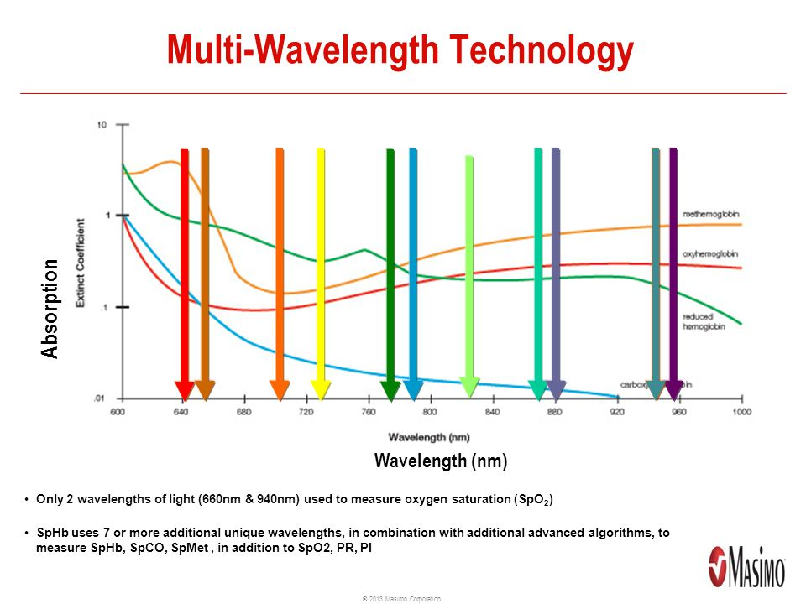
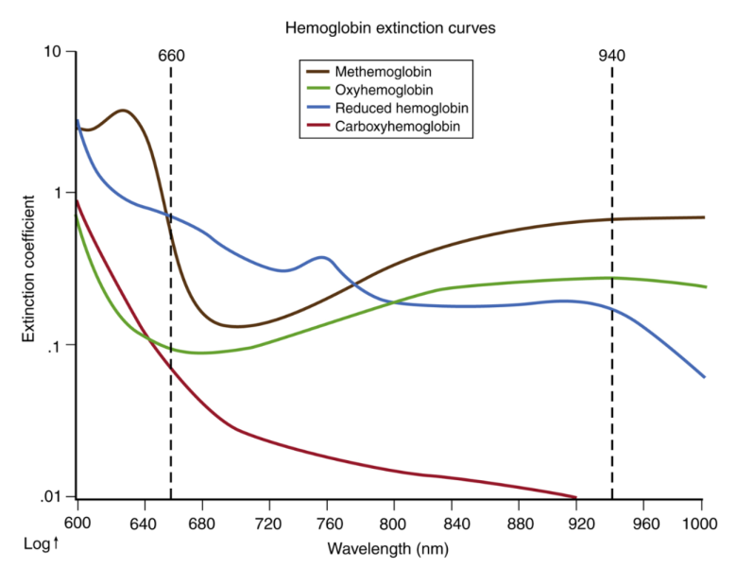
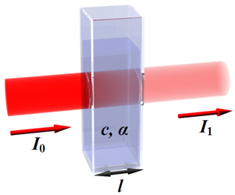
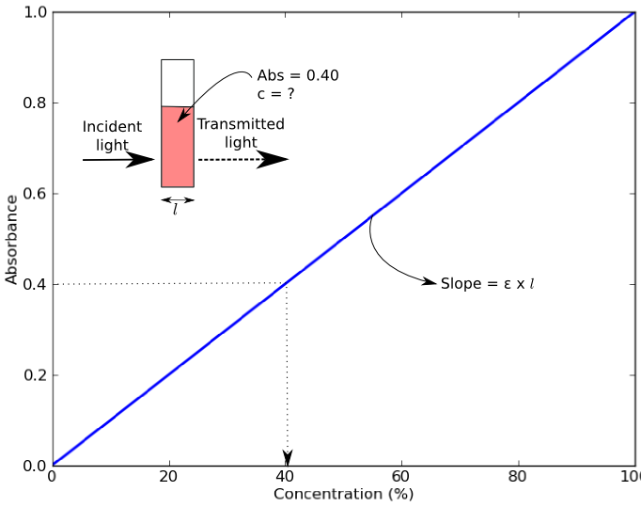
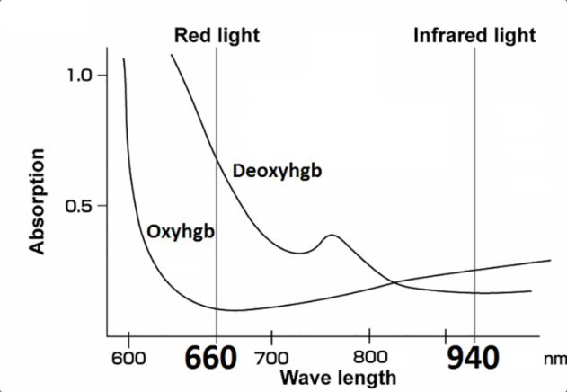
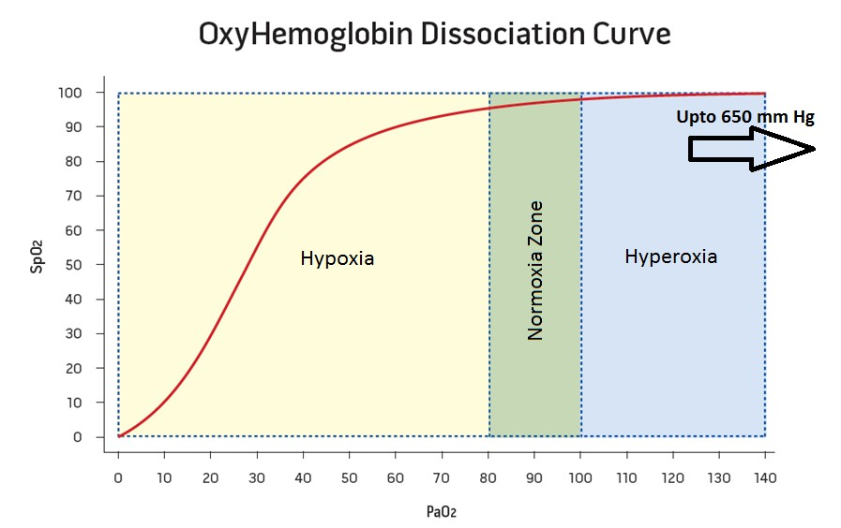
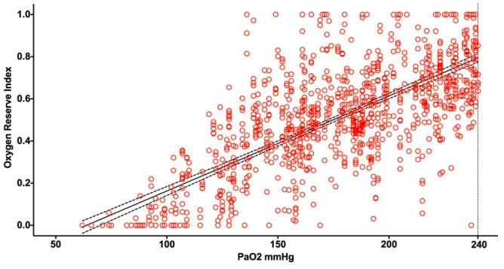
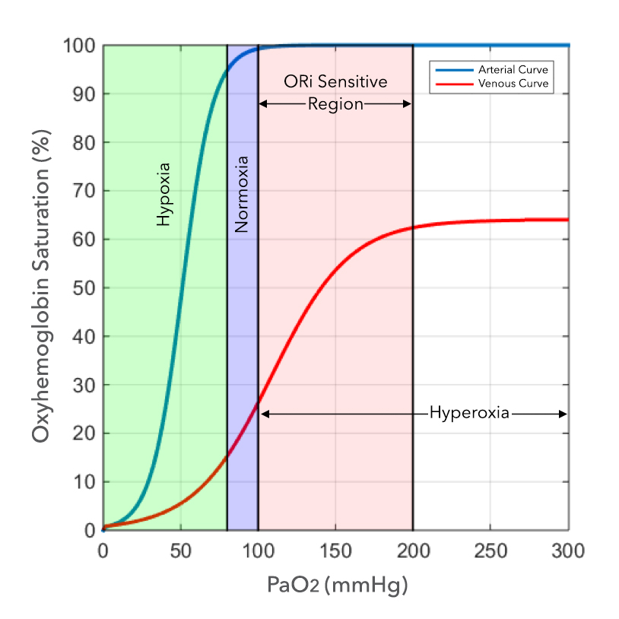
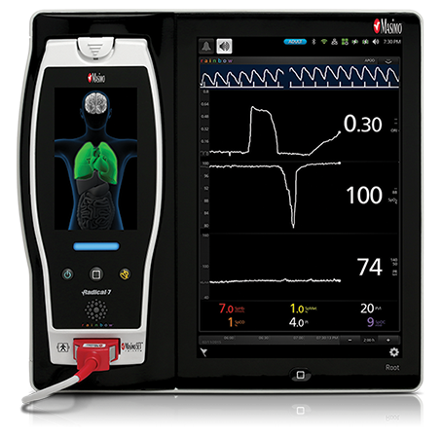
OXYGEN RESERVE INDEX: UTILITY AS EARLY WARNING FOR DESATURATION IN MORBIDLY OBESE PATIENTS
Sebastian Ayala, BS, Amrik Singh, MD, Richard Applegate II, MD, Neal W Fleming, MD, PhD
Department of Anesthesiology & Pain Medicine, UC Davis School of Medicine
Introduction
Results
Pulse oximeters emit light and detect changes in light according to Beer-Lambert’s law: the amount of light absorbed is proportional to the concentration of hemoglobin(Hb) in the blood.
The evolution of IR technology now allows multiple (7+) wavelengths and provides information with diverse clinical utility.
ORI advanced warning:
ORI alarm start to 94% saturation
Enrolled and Analyzed |  | n = 36
Gender | Female | 19
 | Male | 17
Age (years) ± SD |  | 59 ± 13.9 (min-25, max-82)
BMI ± SD |  | 34 ± 2.5 (min-30, max-39)
ASA Classification n= (1/2/3/4) |  | 2/14/18/2
Times from start intubation (s) ± SD | intubation complete | 48 ± 26 s (min-13, max-112)
 | tolerable apnea (to SpO₂=94%) | 262 ± 86.9 (min-104, max-439)
 | ORI warning (start to SpO₂=94%) | 92±46.2 s (min-27, max-264)
 | SpO₂ warning (SpO2=97%to 94%) | 38±19.3 s (min-11, max-83)
Oxyhemoglobin absorbs more infrared light than red light, the opposite is true for deoxyhemoglobin.
Current clinical applications:
Met- and Carboxy- Hgb
Continuous Hgb
Oxygen Reserve Index
Most recently developed parameter shown to correlate with arterial oxygen concentration (PaO₂).
ORI is presented on a unit-less scale between 0 and 1, which correlates with PaO₂ values between 100 and 200 mmHg.^{1,2}
Pulse ox. detects peak absorbance for both forms of Hb; 650nm (red) and infrared light at 950nm. An algorithm utilizes the ratio of peak absorbances between red and infrared wavelengths and calibrates using correction factors.
Summary
Methods
Average increase in warning time ORI vs. SpO₂
54±34.8 s (range 13 to 206).
Prospective, observational study designed to evaluate the clinical utility of ORI as an early warning of arterial hemoglobin desaturation in obese patients (BMI>30, <40 kg/m² ).
ORI values were recorded at five time points: baseline, end-of pre-oxygenation, start of intubation, 94% SpO₂, and a final plateau.
This additional warning time can potentially translate to improved patient safety by allowing:
Earlier calls for help
Assistance from more experienced person
Modification of airway management.
References / Acknowledgements
1. Szmuk P, Steiner JW, Olomu PN, et al. Oxygen Reserve Index: A Novel Noninvasive Measure of Oxygen Reserve - A Pilot Study. Anesthesiology 2016;124(4):779-784.
2. Applegate RL, Dorotta IL, Wells B, et al. Relationship Between Oxygen Reserve Index and Arterial partial Pressure of Oxygen During Surgery. Anesth Analg 2016;123:626–33
This Project was funded by Masimo, Inc.
Notes:
The more Hb in a given unit area, the more light is absorbed. In addition, the amount of light absorbed is proportional to the length of the path that the light has to travel, spanning the area of the artery and finger but correcting for non-pulsatile changes, and only utilizing absorbance from pulsatile absorbances.

