Slide 1

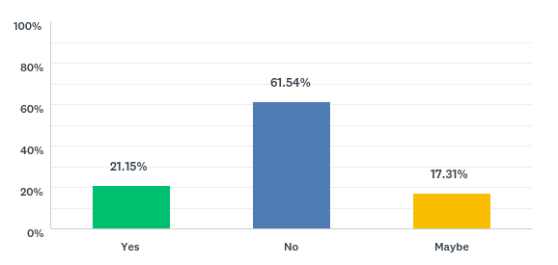

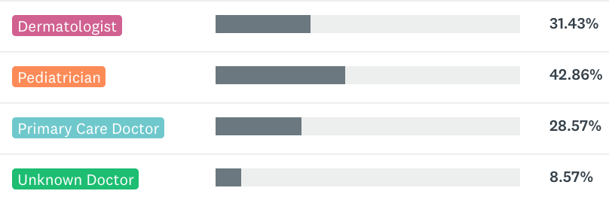
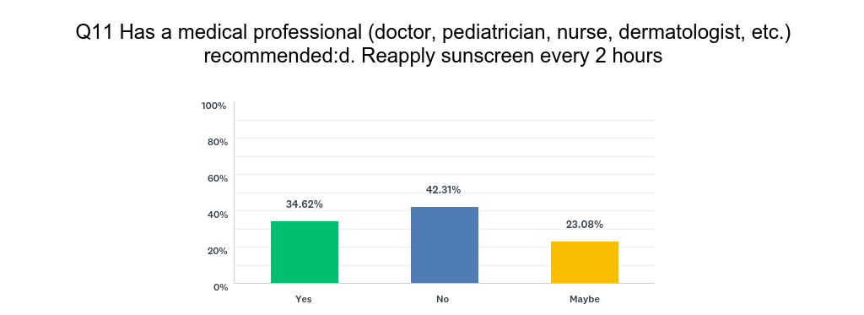
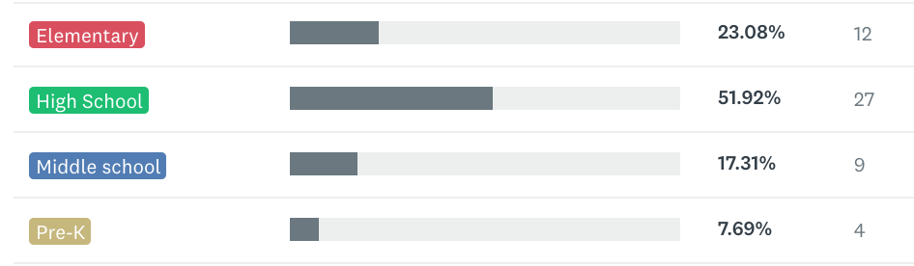
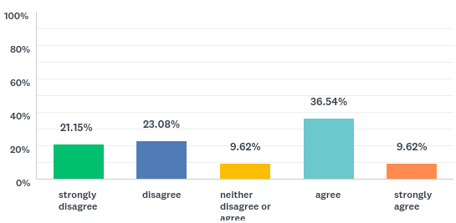
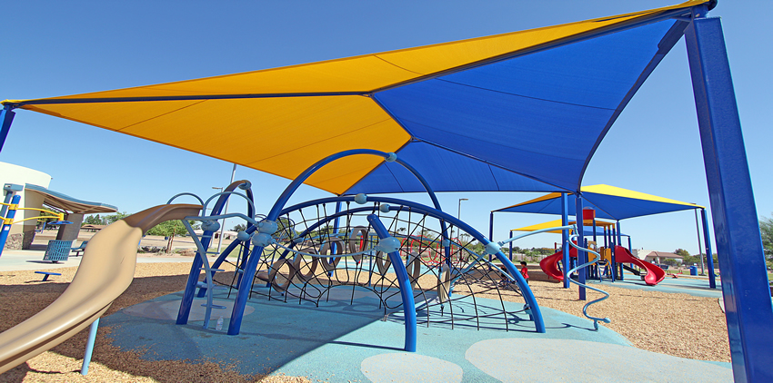
Sunscreen Recommendations & School Support in Pediatric Populations
Ashley K. Clark¹, Smitha Awasthi² MD, Raja K. Sivamani² MD
University of California- Davis School of Medicine¹, Department of Dermatology, University of California-Davis²
Introduction
Materials and Methods
Results
Conclusions
The rapidly increasing incidence of melanoma and the large number of non-melanoma skin cancers have made skin cancer a significant public health problem. Excessive exposure to ultraviolet radiation, history of sunburns, or living in areas with high levels of ambient UV radiation during childhood and adolescence has been associated with an increased risk of melanoma.¹ Sunscreen is an important part of sun protection to prevent skin cancer but may not be recommended as often as guidelines suggest. Currently, little is known regarding parental perception of professional counseling and support from schools to reduce skin cancer risk among the pediatric population.
52 subjects were recruited from the University of California Davis Dermatology Department, Sacramento, Davis and surrounding areas. Adults were asked if they have school-aged children and would like to participate in an anonymous survey.
Surveys were deployed in person using an Ipad interface.
Additionally, subjects were recruited through online parenting forums and facebook groups.
Has a medical professional recommended sunscreen use and reapplication?
Multiple health care organizations highly recommend physicians educate patients on sunprotective behaviors, including proper sunscreen use, however, previous studies indicate physicians mention sunscreen at a very low percentage. Children and adolescents in elementary school compared to the older high school age groups were more likely to receive recommendations for sunscreen us.
In the present study, pediatricians comprise a large portion of the medical professionals who are recommending sunscreen use to families. New guidelines advise pediatricians to discuss sun protection at least yearly during health maintenance examinations potentially aiding in the high rate of recommendations among pediatricians compared to other health professionals.
Parental perception of school support for sun protective measures remains evenly split. This appears to be a change from previous perceptions when lack of school support of sun protection obtained large media attention. In recent years, the CDC and American Cancer Society have advocated for the implementation of school interventions, which may contribute to the increased support from schools.
If so, who recommended proper sunscreen use?
Research Question
Analysis
Do medical professionals and schools provide adequate counseling and support to reduce skin cancer risk among the pediatric population?
Aim 1: Identify the percentage of patients that recall receiving counseling regarding proper sunscreen use from their primary care providers in a cohort of patients seen at the UC Davis dermatology clinic.
Aim 2: Identify if schools provide sun proactive measures such as shaded playgrounds, use of sun protective clothing or sunscreen, and promote sun safety practices.
Outcome Measures:
Counseling:
Survey results indicating study subjects received counseling (or not) from a medical professional.
School support:
Survey results indicating study subjects receive support (or not) from schools for sun protection.
Does your child’s school encourage and promote sunscreen use?
Respondent Demographics:
Pre-k: 0-4 yr Elementary: 5-10 yrs Middle School:11-13 yrs High School: 14-18 yrs
My child’s school provides adequate sun protection for my child:
References
1. Green, A. C., Wallingford, S. C., & McBride, P. (2011). Childhood exposure to ultraviolet radiation and harmful skin effects: Epidemiological evidence. Progress in Biophysics and Molecular Biology, 107(3), 349–355. http://doi.org/10.1016/j.pbiomolbio.201
Acknowledgements
Thank you to the UC Davis Department of Dermatology staff and residents. Specifically, I want to thank Dr. Smitha Awasthi for opening her clinic and patient panel and allowing me to deploy surveys during her clinic hours.

