Slide 1

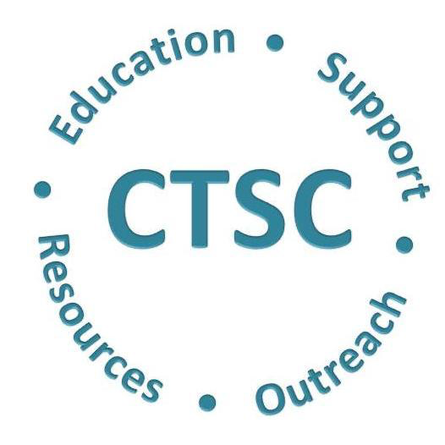

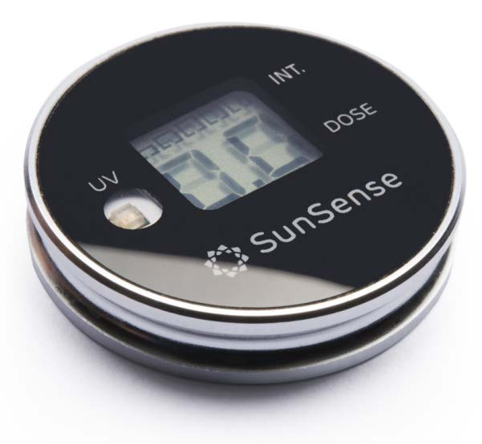
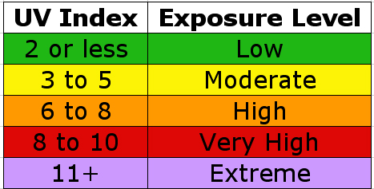
Quantifying Sunlight Exposure in Outdoor Laborers
Lauren A. Hassoun¹, Claribel Solorio¹, Pamela Pimentel², Suzana Saric¹, Raja K. Sivamani²
1. School of Medicine, University of California Davis, Sacramento, CA, USA
2. Department of Dermatology, University of California Davis, Sacramento, CA, USA
HYPOTHESIS
METHODS
In outdoor workers, there will be statistically significant differences in cumulative ultraviolet radiation at different body sites (arm vs. back).
Sun Sensors:
Sunlight measurement devices (SunSense®): standalone wearable devices used for personal sun exposure monitoring and awareness
UV level and accumulated dose easily displayed at a glance
BACKGROUND
Skin cancer is the most common skin cancer in the US: 1 in 5 Americans will develop skin cancer in their lifetime
Sun exposure is the single most important causal factor in determining overall skin cancer risk
Sun damage (freckling, wrinkling and solar lentigos) is associated with melanoma with the strongest associations observed for the dorsal parts of the body (i.e. back)
People in outdoor occupations frequently have excessive exposure to ultraviolet radiation.
Outdoor workers are more often of low SES often with numerous barriers in obtaining health care, such as low income, low health literacy, inadequate resources and transportation, low health insurance enrollment, and limited access to local community public health programs.
Global Solar UV Index (UVI): level of solar UV radiation at the Earth’s surface. Values range from zero upward – the higher the index value, the greater the potential for damage to the skin and eye, and the less time it takes for harm to occur.
UVI is an important vehicle to raise public awareness of the risks of excessive exposure to UV radiation, and to alert people about the need to adopt protective measures.
UV dose = UV index * hour(s)
Study design:
Outdoor workers at future site of Betty Irene School of Nursing Building (n =10)
Each worker with two (2) sun sensors- one (1) clipped to their sleeve and one (1) clipped to their collar on their back.
Cumulative UV dose from each sensor was measured every hour for three hours (12:30 - 3:30 pm)
Levene’s Test for Equality of Variances demonstrated p=0.06, therefore the non-parametric test Mann-Whitney was used to compare the UV dose values at arm vs. back sites. Mann-Whitney: cumulative UV dose values measured at arm vs. back were statistically significant with p = 0.02.
CONCLUSIONS
In conclusion, this study of limited sample size found that the overall cumulative UV dose measured on the arm was statistically higher than that measured on the back of those working outside
These results are in contrast to other data that found that on average people experience more UV radiation on their back, a predictor for melanoma risk
Future studies of larger sample size and other body sites are needed to elucidate more with regards to UV radiation dose and skin cancer risk
Figure 1: SunSense® wearable device
ACKNOWLEDGEMENTS
RESULTS
Dr. Raja K. Sivamani
Lance Durfee, PE, CCM
Tyler Slothower, Construction Manager
Vanir Construction Management, Inc.
Fiona Scott, MPH, MS, MHI
Dr. Saul Schaefer
Table 1: UV Radiation Exposure Categories
REFERENCES
Heckman, C. J., & Cohen-Filipic, J. (2012). Brief report: Ultraviolet radiation exposure, considering acculturation among Hispanics (Project URECAH). Journal of Cancer Education, 27, 342- 346. doi:10.1007/s13187-011-0308-x
Hu, S., & Kirsner, R. S. (2011). Suboptimal skin cancer screening and delayed melanoma diagnosis in Hispanics: Comment on “Cutaneous melanoma and other skin concern screening among Hispanics in the United States.” Archives of Dermatology, 147, 745-746.
LeBlanc, W. G., Vidal, L., Kirsner, R. S., Lee, D. J., Caban- Martinez, A. J., McCollister, K. E., & Fleming, L. E. (2008). Reported skin cancer screening of US adult worker. American Academy of Dermatology, 59, 55-63.

