Slide 1


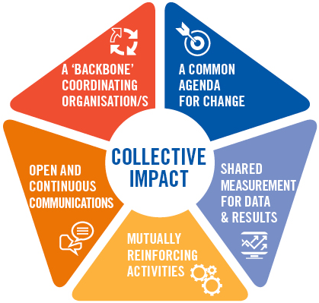
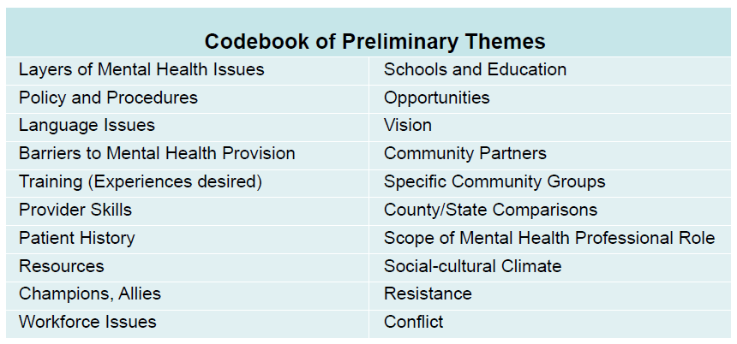
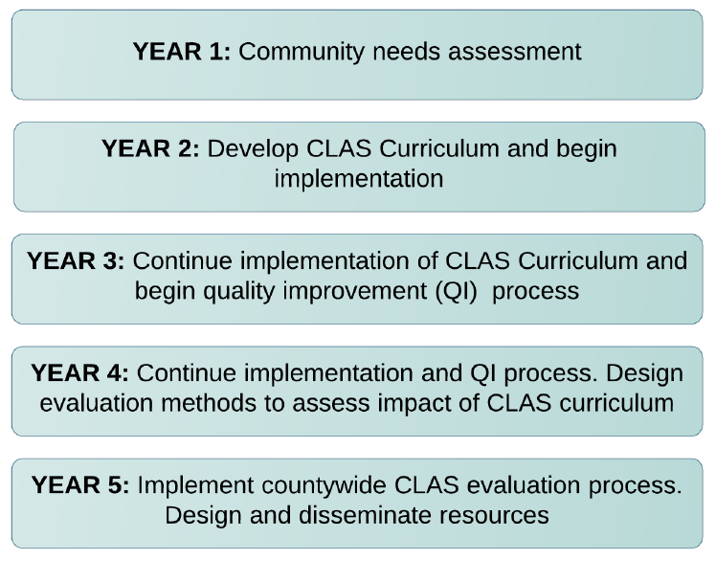
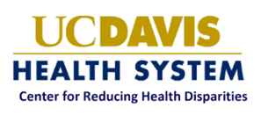
Solano County Behavioral Health Innovation Plan – A Cultural Transformation Model: Year 1
Callum Rowe, MS2 and Hendry Ton, MD, MS
Center for Reducing Healthcare Disparities
Medical Student Research Fellowship, UC Davis School of Medicine
The Solano Project Overview
References
Using funding from the Mental Health Services Act (MHSA), an act designed to reorganize California's various public mental health systems, the Solano Cultural Transformation Model is a novel approach to improve access to and utilization of mental health services by seriously mentally ill adults and severely emotionally disturbed children/adolescents in three underserved populations: the Filipino-American, Latino and LGBTQ communities.^{6,7,8}
Traditional approaches aim to engage and serve these communities by focusing primarily on providers’ skill sets, community engagement events, and publicity. This project takes a decidedly different approach to these challenges, engaging consumers, community and organizational leaders, advocates, and County and contract staff in a collaborative education, training, and problem solving process using the principles of Collective Impact and the Culturally and Linguistically Appropriate Services Standards (CLAS), a set of nationally accepted standards for cultural proficiency in service organizations.⁶ The approach will feature building teams of key stakeholders, who once formed and trained, will ensure that the standards for CLAS are being met or exceeded using well-tested quality assurance and evaluation approaches.
Methods
1. Beach, M. C., Cooper, L. A., Robinson, K. A., Price, E. G., Gary, T. L.,
Jenckes, M. W., Powe, N.R. (2004). Strategies for improving
minority healthcare quality: Evidence Report/Technology
Assessment, Number 90. PsycEXTRA Dataset. 2004.
Doi:10.1037/e439452005-001
2. Goode, T. D., Dunne, M. C., & Bronheim, S. M. (2006). The evidence
base for cultural and linguistic competency in health care.
(Commonwealth Fund Publication No. 962). Retrieved from
The Commonwealth Fund website:
http://www.commonwealthfund.org/usr_doc/Goode_evidenceb
asecultlinguisticcomp_962.pdf
3. The Hive. "Collective Impact." United Way Australia, 20 Feb. 2014.
Web. 14 Feb. 2017.
http://unitedway.com.au/collective-impact-3
4. HHS, The national CLAS standards. Office of Minority Health, 2014.
5. HHS, MinorityHealth. "What Is CLAS?" Think Cultural Health. HHS
Office of Minority Health, 1212. Web. 15 Feb. 2017. https://www.thinkculturalhealth.hhs.gov/clas/what-is-clas
6. Scheffler, R.M. and N. Adams, Millionaires and mental health:
Proposition 63 in California. Health Affairs, 2005. 24: p. W5.
7. Solano County’s Behavioral Health Department. (n.d.).
Mental Health Interdisciplinary Collaboration and Cultural Transformation Model. Solano County. (2005)
8. Valley Vision, A Community Health Needs Assessment of the Solano
County Service Area. 2013.
9. Visla , J. (2016). Solano County Behavioral Health Innovation Plan –
A Cultural Transformation Model.
A survey tool consisting of open-ended questions was designed to guide the discussion, amongst other important issues, to problems with Mental Health Service utilization within the three populations and topics associated with Collective Impact and CLAS standards. The tool was used to interview 7 County employees, identified, by Solano County Department of Health and Human Services and the CRHD research team, as being of and/or serving the Filipino-American, Latino or LGBTQ community; i.e. one of the three target communities.
Of the 7 interviewees: 2 represent the Filipino community, 2 represent the Latino community, 2 represent the LGBTQ and 1 represents the MHS administration. The interviews were conducted the Solano County’s Office of Health and Human Services. The interviews were recorded, transcribed and coded using a code index developed through identification of repeated themes throughout the interviews. These codes were then used to analyze the most important issues identified by the interviewees.
Objectives
The Cultural Transformation Project has concluded its first year. During this year, the Center for Reducing Health Disparities (CHRD), guided by the principles of Collective Impact and the Culturally and Linguistically Appropriate Service (CLAS) standards, conducted individual and focus group interviews with County officials, community leaders from the three populations and community-based organizations servicing the three communities of interest.⁸ This is an important aspect of Collective Impact in which CHRD aims to gauge what matters most to the aforementioned communities, as they are mutual ‘stakeholders,’ in the development of the project. The concerns and objectives of the various stakeholders: Solano County Mental Health administrators, providers, community-based organization and community members, must overlap to create a balanced plan for a re-envisioning of Solano County’s Mental Health Services (MHS).
Figure 2. What is Collective Impact?³
Table 1. Interview Codes⁹
Results and Discussion
Collective Impact calls for input from all stakeholders. The analysis of these 7 interviews focused on the perspectives and objectives of County MHS employees; one component of the initial interviewing of all stakeholders.
The analysis of the coded interviews allowed the team to develop a descriptive understanding of the County’s strengths and challenges. Additionally, it helped the CHRD to identify future interviewees, as well as refine the survey tool to better capture the most pressing issues concerning Solano County MHS in its aim to better serve the Filipino-American, Latino and LGBTQ communities.
Later in Year 1, the survey tool was refined to reflect the most prominent themes that arose from the first 7 interviews. Additionally, the themes have contributed to the design of a Solano County specific CLAS training that will be conducted in Year 2.
What is CLAS?
Acknowledgments
Culturally and linguistically appropriate services (CLAS) is one strategy to help eliminate health inequities. By tailoring services to an individual's culture and language preferences, health professionals can help bring about positive health outcomes for diverse populations.
The provision of health services that are respectful of and responsive to the health beliefs, practices, and needs of diverse patients can help close the gap in health outcomes.^{1,2,4,5}
Jasmine Visla, MPH
UC Davis Center for Reducing Health Disparities Team
Solano County Mental Health Services
Latino, Filipino, and LGBTQ Communities of Solano County
Figure 1. The Five Year Plan⁹

