Slide 1


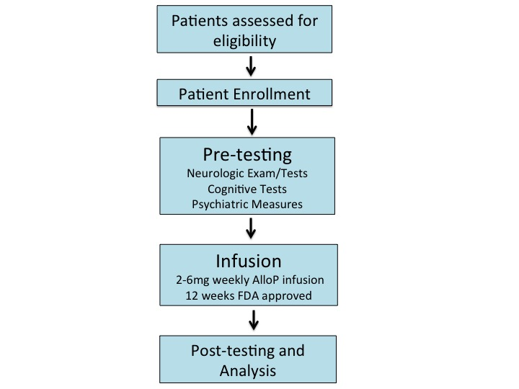
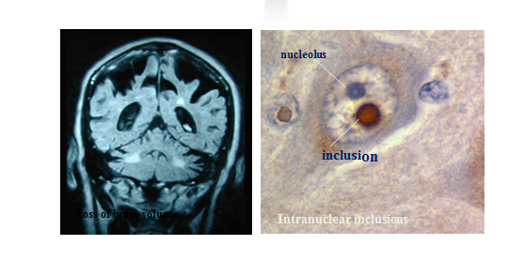
An Open Label Study of Allopregnanolone Treatment for
Fragile X-associated tremor/ataxia syndrome (FXTAS)
Aditi Trivedi¹, Nika Carrillo¹, Randi Hagerman^{1,2}, M.D.
¹University of California, Davis School of Medicine, Sacramento, CA, USA
²MIND Institute and Department of Pediatrics, University of California, Davis School of Medicine, Sacramento, CA, USA
INTRODUCTION
RESULTS
DISCUSSION
CONCLUSIONS
FXTAS is a progressive neurodegenerative condition that manifests with intention tremor, gait ataxia, white matter disease, nuclear inclusions and global brain atrophy. It arises from a 55-200 CGG repeat expansion in the 5’ UTR of the FMR1 gene on the X chromosome¹. This leads to mRNA toxicity, sequestering important proteins for neuronal function and causing a spectrum of phenotypes including cognitive decline with memory and executive function deficits initially and subsequent dementia. Currently targeted treatments directed at the disease have not been established². Allopregnanolone (AlloP) is a natural neurosteroid, which has also been shown to stimulate neurogenesis in the hippocampi of rats, an area involved in memory consolidation. AlloP alleviated spike discharges in premutation neuronal cell culture, and was beneficial for the premutation neurons in culture and the premutation mouse^{3,4}. So, we proposed that AlloP would be beneficial for FXTAS, and help reduce cognitive symptoms in patients with FXTAS.
B
All showed improved executive function
  +21.05% average improvement among all 6 patients (BDS-2)
Variable change in verbal fluency and cognitive flexibility
  average change of +0.05% (COWAT)
Variable change in immediate recall
  Changes ranging from -17.24% to +24.17% (CVLT-II)
Cognitive function and mental status improved or remained the same in 5/6 patients
  average increase in scores of 5.36% (MMSE)
Auditory, Visual and Immediate memory improved by 1.76%, 7.82% and 4.99% respectively, on average; Delayed memory declined by 9.20% on average, measured through WMS-IV
Anxiety levels decreased or remained the same in 3 of the 4 patients
  average change of -14.46%, as measured through the BAI
Reduced Depression, Psychological distress on average among all 6 patients (SCL-90)
Increased anxiety by 1.65% on average (SCL-90)
Other symptoms:
  No improvement in tremor
  Subjective improvement in gait ataxia, conversational skills, linear thought, neuropathic pain
  ERP and MRI neurocognitive tests validate improvements in semantic processing and neuroregeneration
The results suggest AlloP is improving the neuro-psychological symptoms of patients with FXTAS and may be slowing or reversing the neurological decline. AlloP treatment seems to be improving several cognitive impairments seen in FXTAS. Improvements were seen in delayed memory executive function, cognitive performance and slightly, verbal fluency. Strong evidence for improvement in executive function was indicated by the BDS-2 results, suggesting improvement in frontal cortex involvement with AlloP treatment. High variability in the results for several memory and cognitive subtypes indicates the need for further studies including a controlled trial of AlloP.
A
C
D
E
FUTURE DIRECTIONS
Before it can be used as a targeted treatment for the cognitive and neurologic phenotypes of FXTAS, further study must be conducted to understand the mechanism and effects better. We hope to conduct a larger double blind, placebo controlled trial assessing the efficacy of Allopregnanolone as a treatment for FXTAS and explore the neurobiological basis of AlloP with outcome measures that include neuroimaging and more quantitative tests and biomarkers.
METHODS
F
Cognitive skills were assessed at baseline and post infusions using the following outcome measures:
Behavioral Dyscontrol Scale-2 (BDS-2)
Controlled Oral Word Association Test (COWAT)
California Verbal Learning Test-II (CVLT-II)
Mini Mental Status Exam (MMSE)
Weschler Memory Scale-IV (WMS-IV)
REFERENCES
G
1. Hagerman R.J., Leehey M, Heinrichs W, Tassone F, Wilson R, Hills J, Grigsby J, Gage B, Hagerman P.J. Intention tremor, parkinsonism and generalized brain atrophy in male carriers of fragile X., Neurology. 2001; 57(1): 127-30.
2. Hagerman R.J., Hagerman P.J. Advances in clinical and molecular understanding of the FMR1 premutation and Fragile x-associated tremor/ataxia syndrome., The Lancet Neurology. 2013 (12): 786-98.
3. Irwin, R.W., Brinton, R. D. Allopregnanolone as regenerative therapeutic for Alzheimer's disease: translational development and clinical promise., Progress in neurobiology. 2014: 113, 40-55.
4. Cao Z., Hulsizer S., Tassone F., Tang H., Hagerman R., Rogawski M., Hagerman PJ., Pessah I. Clustered Burst Firing in FMR1 premutation hippocampal neurons: amelioration with allopregnanolone., Hum Mol Genet. 2012: 21(13): 2923 – 2935.
Psychiatric skills were assessed at baseline and post infusions using the following outcome measures:
Beck Anxiety Inventory (BAI)
Symptom Checklist-90-Revised (SCL-90)
Figure 2: Changes in cognitive function in patients with FXTAS after undergoing 12 week Allopregnanolone infusion treatment. Results depict changes in executive function scores measured through BDS-2 (A), COWAT (B); cognitive function measured through MMSE (C); memory, measured through CVLT-II (D), WMS-IV (E); and psychiatric scores measured through BAI (F) and SCL-90 (G).
ACKNOWLEDGEMENTS
Figure 1: Experiment Overview
This research was made possible by the Medical Student Research Fellowship and the generous contributions of our donors.
Patients were all male between the ages of 50-85 years old.
Hagerman, 2015

