Slide 1


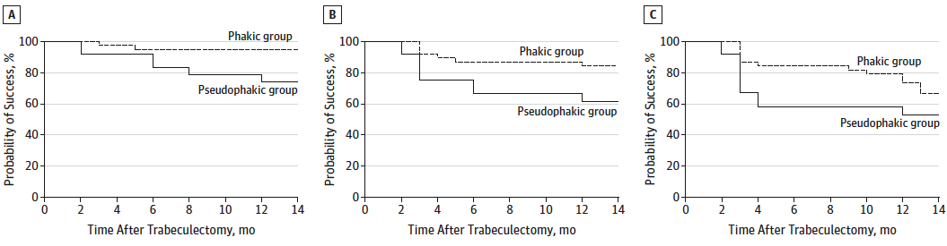
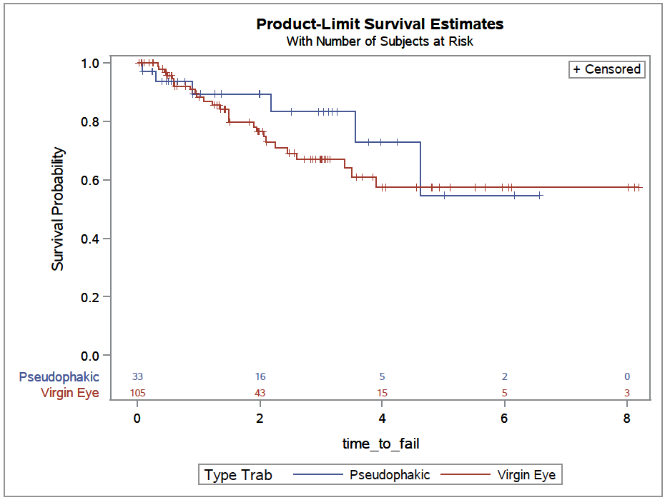
Does prior clear corneal phacoemulsification increase failure rate for trabeculectomy?
Kara Brodie, MPhil., Jennifer Edith De Niro, M.D., Michele Lim, M.D., James Brandt, M.D., Mitch Watnik, PhD., Ilana Traynis, M.D.
University of California – Davis, School of Medicine
INTRODUCTION
METHODS
RESULTS
DISCUSSION
A trabeculectomy is a surgical intervention for glaucoma to lower intraocular pressure (IOP). Previous research has shown that trabeculectomies are less successful in eyes that have had previous surgery that injures the conjunctiva, including extracapsular cataract surgery, scleral tunnel phacoemulsification, and pterygium surgery. These surgeries involving the conjunctiva promote scarring by increasing conjunctival fibroblasts and inflammatory cells.
One prospective study from Japan compared trabeculectomy success in phakic and pseudophakic eyes¹. In this study, the patients with pseudophakic eyes had undergone cataract surgery involving a small, conjunctival incision. The study found that phakic eyes had higher likelihood of maintaining controlled IOPs after trabeculectomies compared to the pseudo-phakic eyes.
We performed a retrospective chart review at UC Davis from 2007 to 2015 using trabeculectomy billing codes.
Exclusion Criteria:
Age ≤ 18 years
Pre-trabeculectomy IOP <18 mm Hg
Previous intraocular or conjunctival surgery (other than cataract surgery)
Prior complicated phacoemulsification surgery (vitreous loss, ACIOL)
Chronic or recurrent uveitis
If both eyes qualified for the study, the eye with the most recent trabeculectomy was excluded.
Main Variables:
Independent Variable:
Lens status: phakic eyes vs. pseudophakic eyes.
Primary Outcome Variables:
IOP failure analysis
Absolute IOP for each measurement window (post op month 3, 6, etc).
Secondary Outcome Variables:
Time to failure for Cox survival analysis
IOP at various time points relative to pre-surgical baseline for each measurement window
Reason for failure
Type of complication
Other reasons to return to OR
Clinical interventions after surgery (5FU, laser suture lysis, etc)
Difference in LogMar Vision between groups at each study time point
Failure Criteria:
IOP-based
  IOP > 21 mm Hg and/or not reduced by 20% below baseline on 2 consecutive follow-up visits after 3 months
  IOP ≤ 5 mm Hg on 2 consecutive follow-up visits after 3 months with loss of vision of ≥ 2 lines
Reoperation for glaucoma
Loss of light perception
Study Population
138 eligible patients:
  105 phakic patients and 33 pseudophakic patients
Average time between cataract surgery and trabeculectomy: 4.5 years ± 4.1 years
Only 4 patients (12%) underwent trabeculectomy within one year of cataract surgery
This study suggests that clear corneal phacoemulsifcation does not affect subsequent trabeculectomy failure rates. No statistically significant differences in IOP changes from baseline between the two groups at any of the time period windows post-surgery (p>0.15). Of the trabeculectomies performed on patients with prior cataract surgery, 18.2% of the trabeculectomies failed in comparison to 24.7% performed on patients without prior cataract surgery, (p=0.77). Survival analysis did not show a statistically significant difference in time until failure.
Therefore, there was not evidence to show that clear corneal phacoemulsification affects trabeculectomy success or failure.
Limitations:
Retrospective study
Relatively small sample size, decreased power
Pseudophakic patients were significantly older
Figure 1. Comparative Success Rates between
Phakic and Pseudophakic Eyes¹
NEXT STEPS
Table 1. Reasons for Failure
Future plans:
According to our power calculations, we will need 91-96 virgin eyes and 57-60 pseudophakic eyes to detect a different of 3 mmHg IOP between the two groups.
We need to double the sample size of pseudophakic eyes.
Continue to collect data over the next three years to increase the sample size for analysis at later time.
Pseudophakic Eyes (n= 33) |  |  | Phakic Eyes (n= 105)
Reason | Total | Percent | Reason | Total | Percent
IOP too high | 1 | 3% | IOP too high | 7 | 6.6%
IOP too low | 0 |  | IOP too low | 5 | 4.7%
Additional Glaucoma surgery | 5 | 15.2% | Additional Glaucoma surgery | 13 | 12.4%
NLP | 0 |  | NLP | 1 | 1%
Total: | 6 | 18.2% | Total: | 26 | 24.7%
However, another study², which compared similar groups showed no statistically significant difference in intraocular pressure (IOP) outcomes. Shortcomings of the two studies include that cataract surgery in the first study involved a conjunctival incision, and trabeculectomy surgery in the second study did not involve the use of anti-metabolite (anti-scarring) medications which are now used ubiquitously.
Our study is a retrospective study that compares the IOP outcomes of patients undergoing trabeculectomy surgery with anti-metabolite in patients who are phakic and in those who are pseudo-phakic after clear corneal cataract surgery (no conjunctival incision).
REFERENCES
Takihara Y, Inatani M, Ogata-Iwao M, et al. Trabeculectomy for open-angle glaucoma in phakic eyes vs in pseudophakic eyes after phacoemulsification: a prospective clinical cohort study. JAMA ophthalmology. Jan 2014;132(1):69-76.
Supawavej C, Nouri-Mahdavi K, Law SK, et al. Comparison of results of initial trabeculectomy with mitomycin C after prior clear-corneal phacoemulsification to outcomes in phakic eyes. Journal of glaucoma. Jan 2013;22(1):52-59.
Figure 3.
Success Rate
ACKNOWLEDGMENTS
OBJECTIVES
I would like to thank Dr. Edie De Niro for her guidance and support throughout this project. Additionally, I would like to thank Dr. Michele Lim and Dr. James Brandt for their expertise and mentorship overseeing this project. Additionally thanks to Dr. Ilana Traynis and Dr. Mitch Watnik for their contribution to the data collection and statistical analysis.
To determine if clear-corneal phacoemulsification prior to trabeculectomy is associated with higher trabeculectomy failure rates compared to trabeculectomy alone. This study aims to provide support to guide clinical management of glaucoma.
Time (years)

